Slide 1
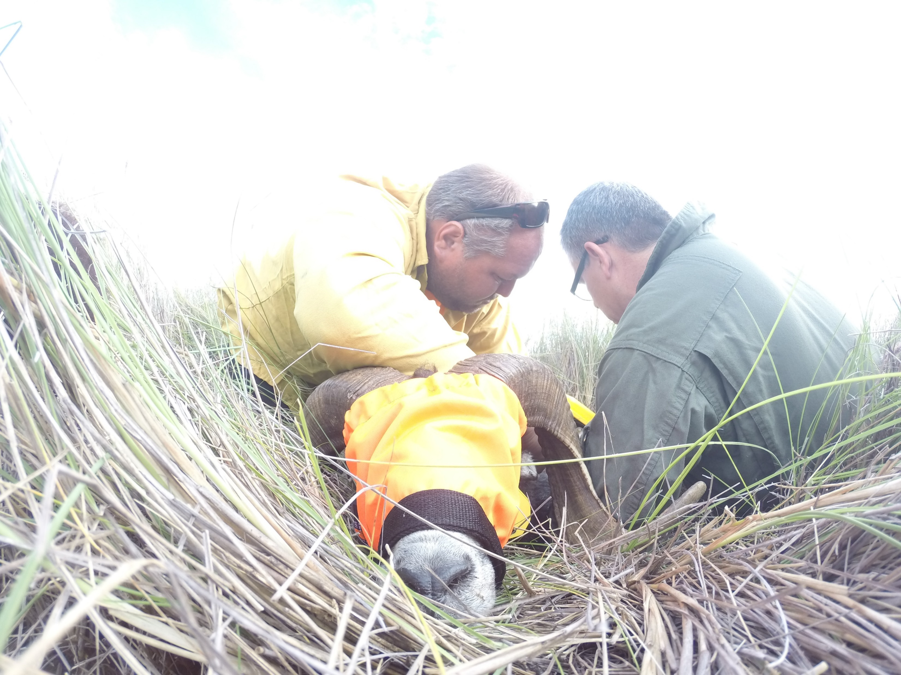
Pu‘u Wa‘awa‘a and Pu‘u Anahulu Habitat Conservation Plan
Game Mammal Management Update

Slide 2
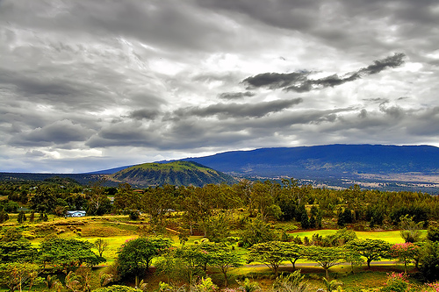
Pu‘u Wa‘awa‘a and Pu‘u Anahulu
HCP Game Mammal Management Update
Habitat Conservation Plan
HCP status
Game Mammal Management
Research
Home Range and Movements
Blood Mineral Sampling
Survival Rates
Abundance Estimation/Camera Traps

Slide 3
Pu‘u Wa‘awa‘a and Pu‘u Anahulu
HCP Game Mammal Management Update
HCP status
HCP Public Review: November 2015
EA Public Review: January 2016
Address Public Comments: April 2016 - present
Draft HCP to ESRC: September 2017
Revised EA to contractors: Fall 2017
HCP and EA to the Board: Spring 2018

Slide 4
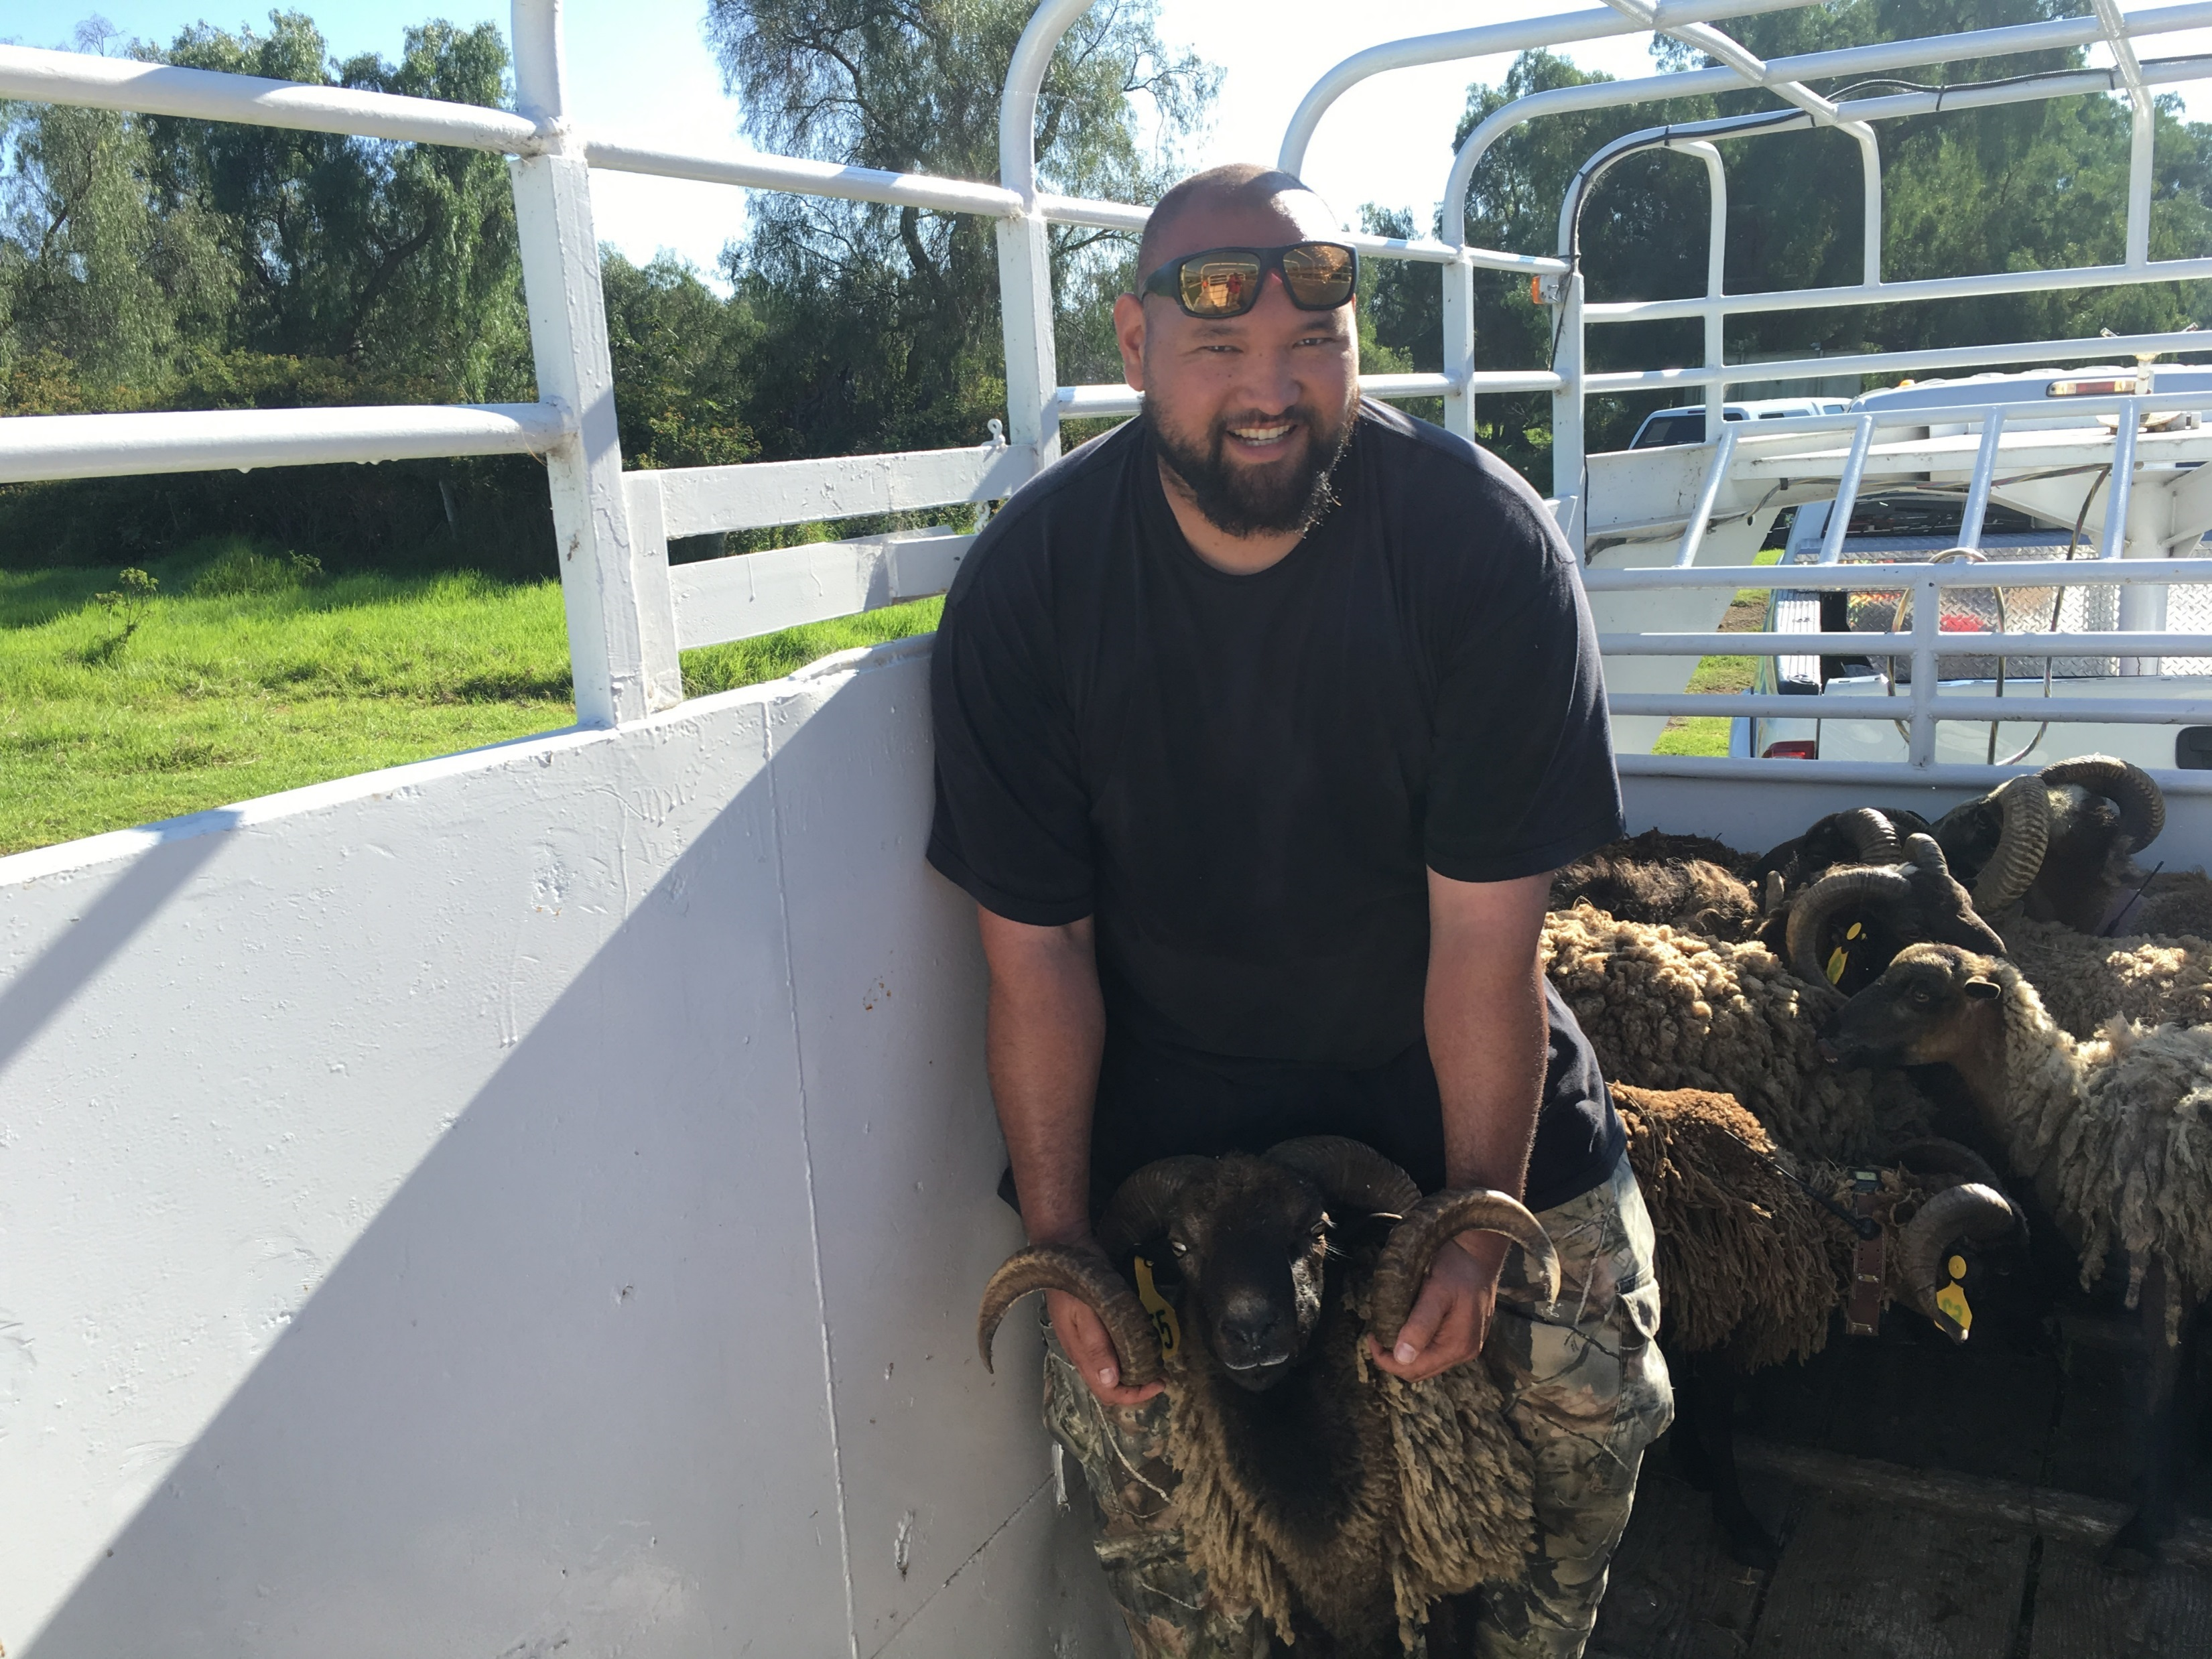
Pu‘u Wa‘awa‘a and Pu‘u Anahulu
HCP Game Mammal Management Update
Summary of animals captured:
Adult females captured: 35
Adult males captured: 33
Female lambs captured: 5
Male lambs captured: 9
Total sheep captured and marked: 82

Slide 5
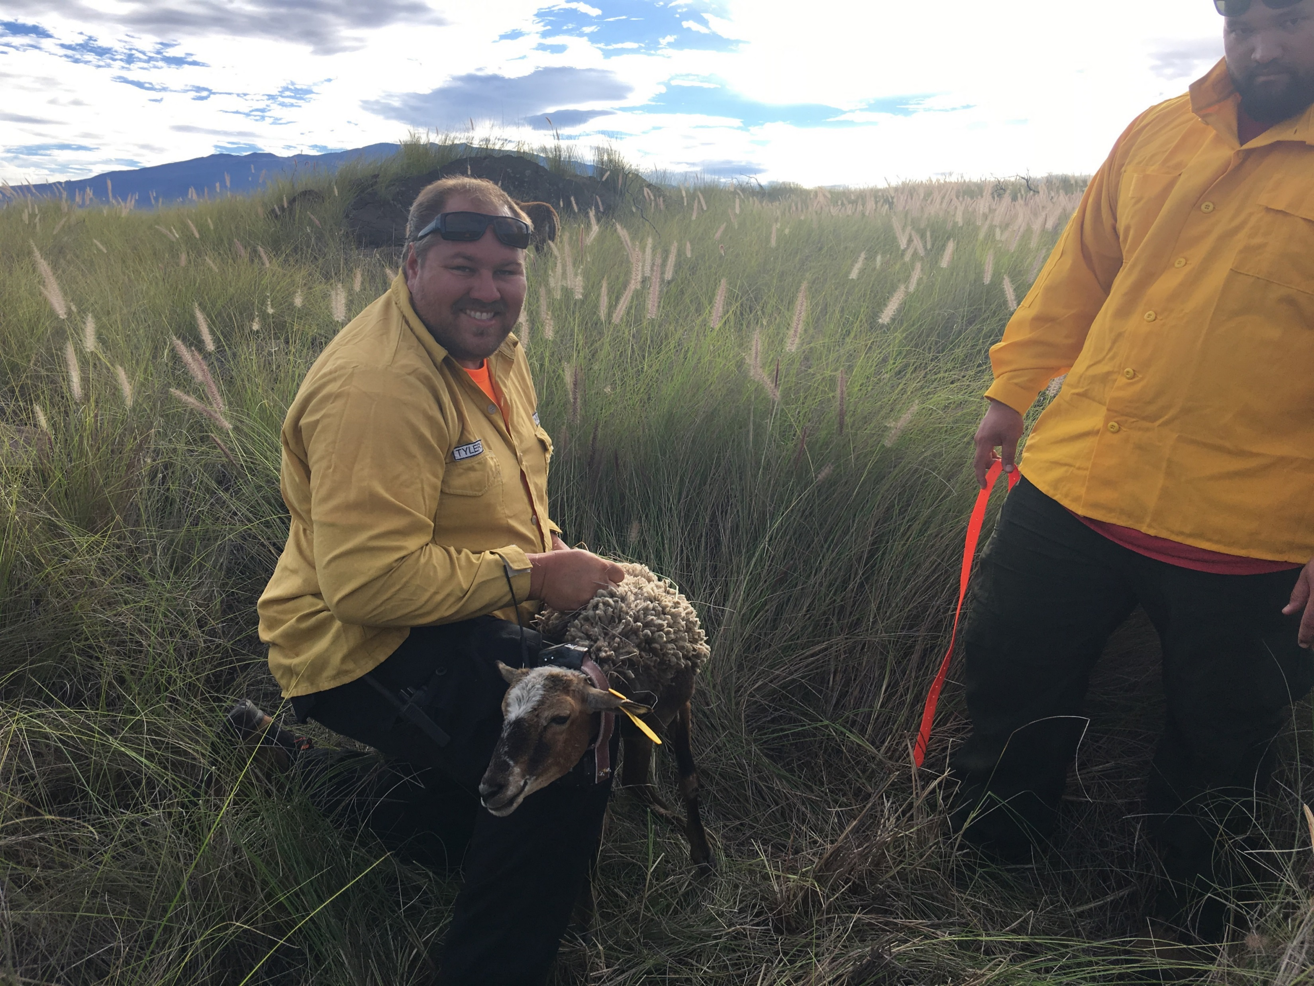
Pu‘u Wa‘awa‘a and Pu‘u Anahulu
HCP Game Mammal Management Update
Summary of animals captured:
Females fitted with GPS collars: 15
Males fitted with GPS collars: 9
Females fitted with VHF collars: 7
Males fitted with VHF collars: 9
Total GPS collars deployed: 24
Total VHF collars deployed: 16

Slide 6
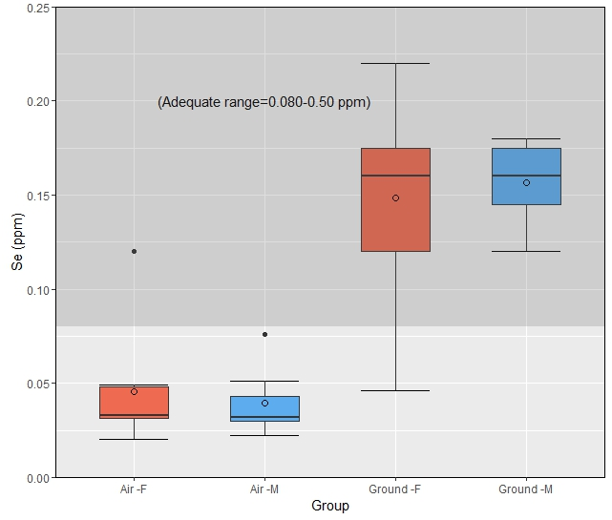
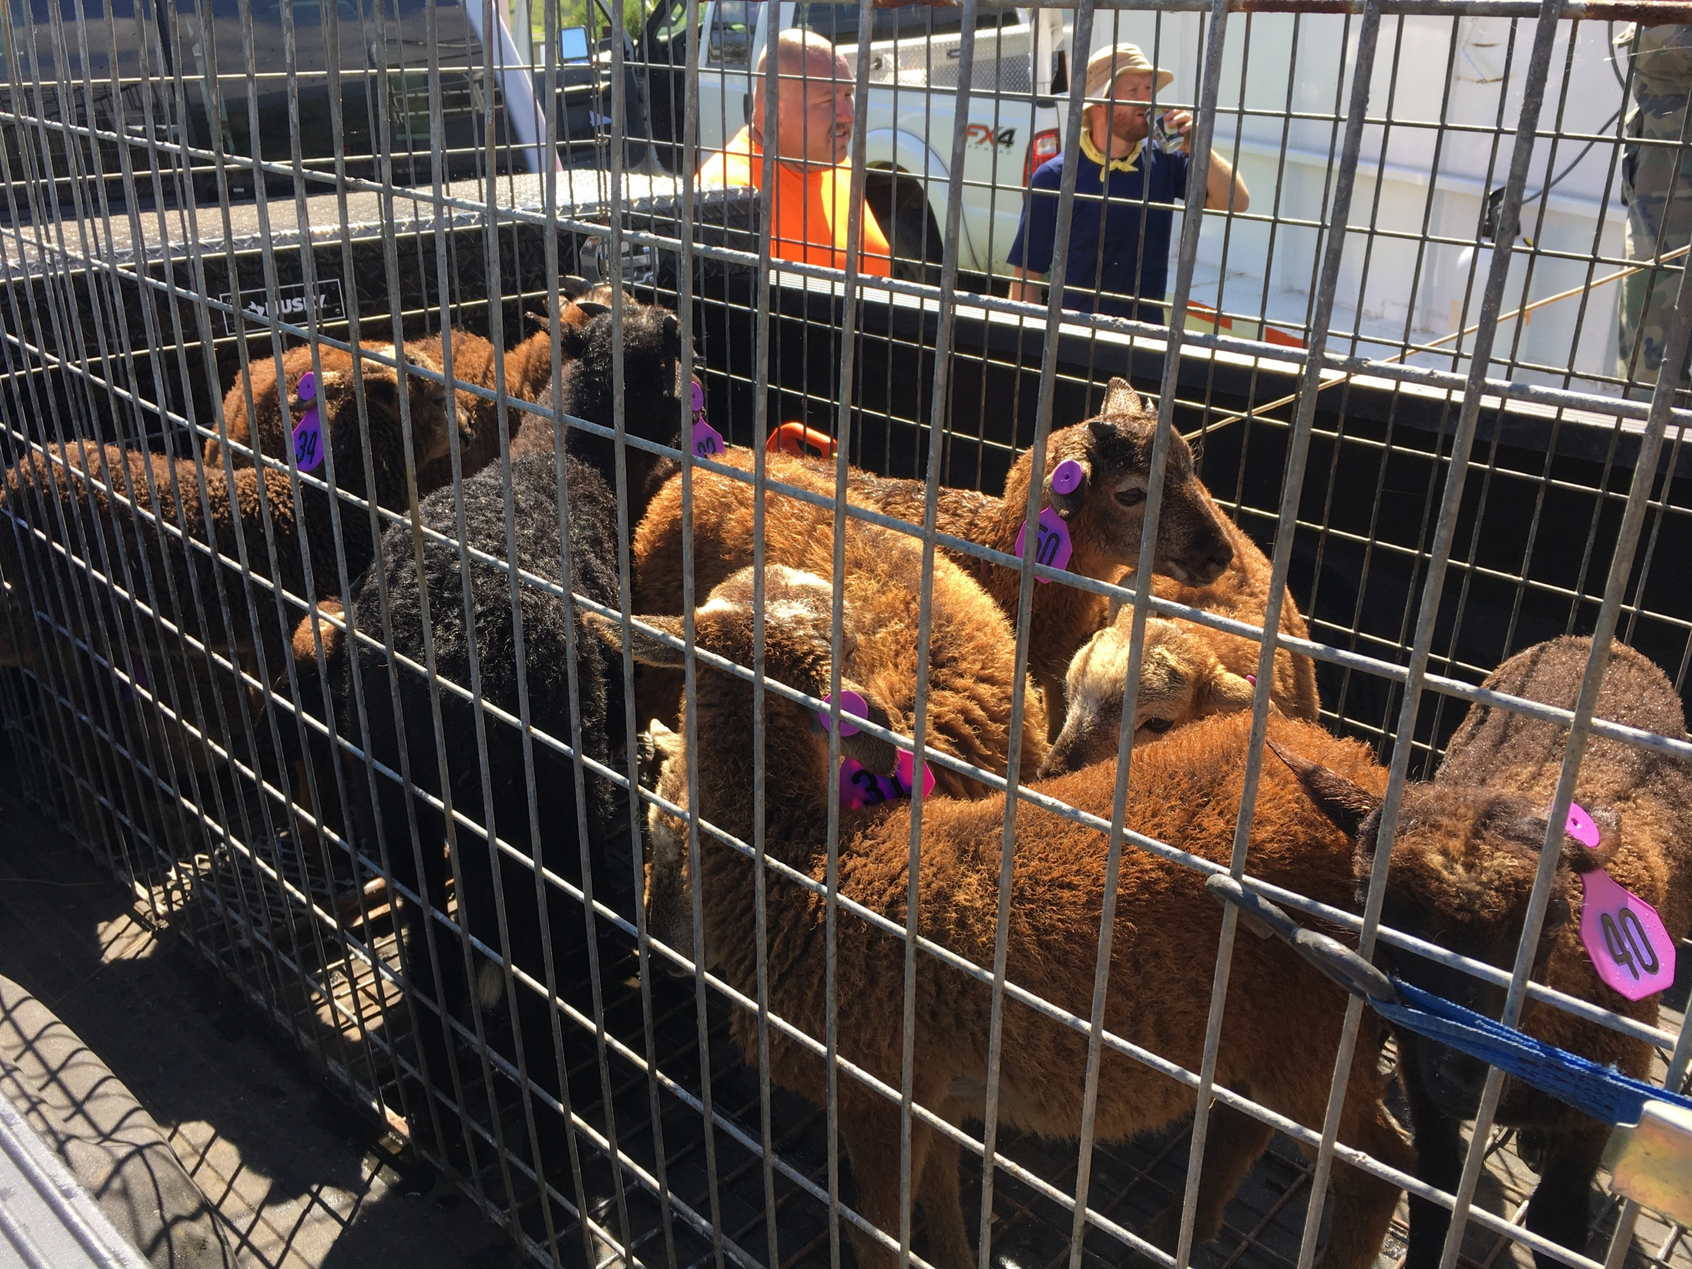
Pu‘u Wa‘awa‘a and Pu‘u Anahulu
HCP Game Mammal Management Update
Blood Samples:
Mineral Profile
DNA Analysis
Pregnancy Test

Slide 7
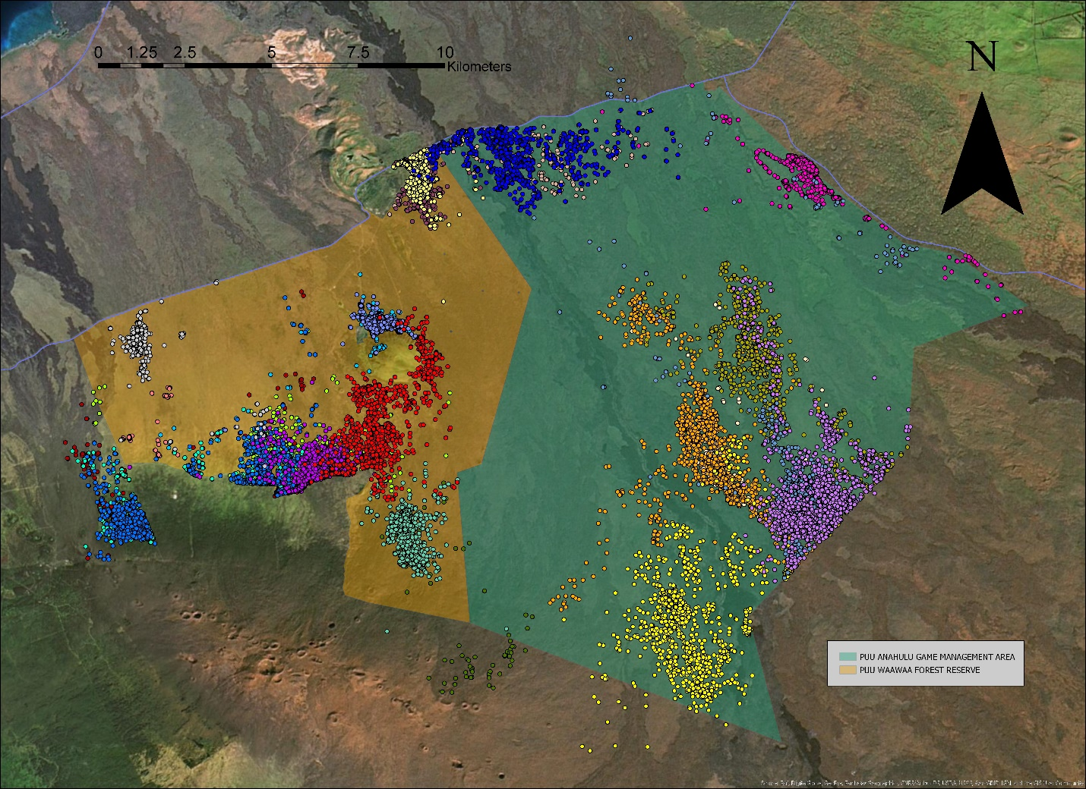
Pu‘u Wa‘awa‘a and Pu‘u Anahulu
HCP Game Mammal Management Update
Home Range and Movements:
Home Range Size: 12.73 square km to 13.35 square km
Average Distance Moved: 7.27 km

Slide 8
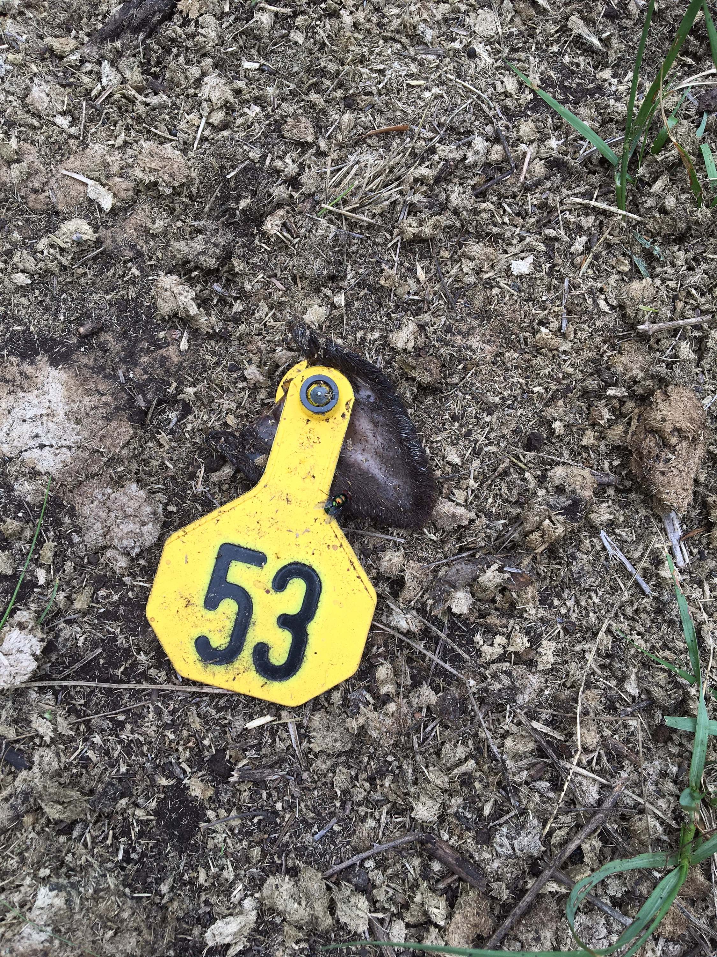
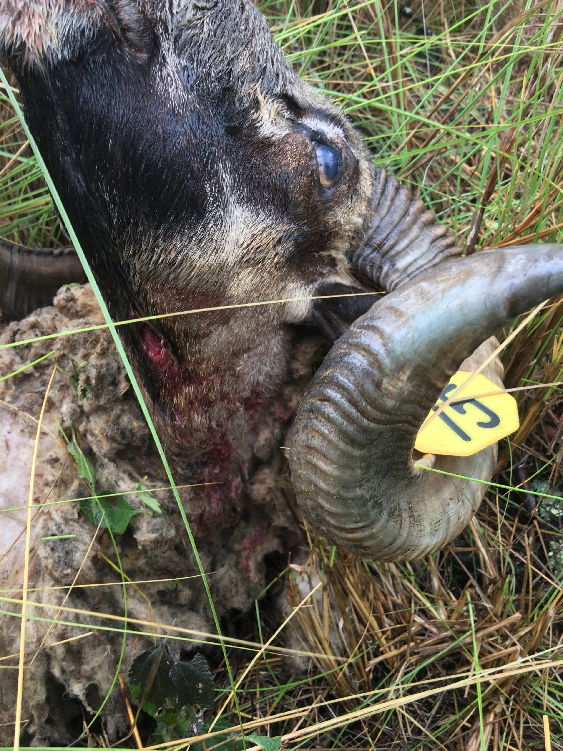
Pu‘u Wa‘awa‘a and Pu‘u Anahulu
HCP Game Mammal Management Update
Survival
3 mortalities. All predated by wild dogs
Predator control ongoing
Annual survival estimates for adults is 90%

Slide 9
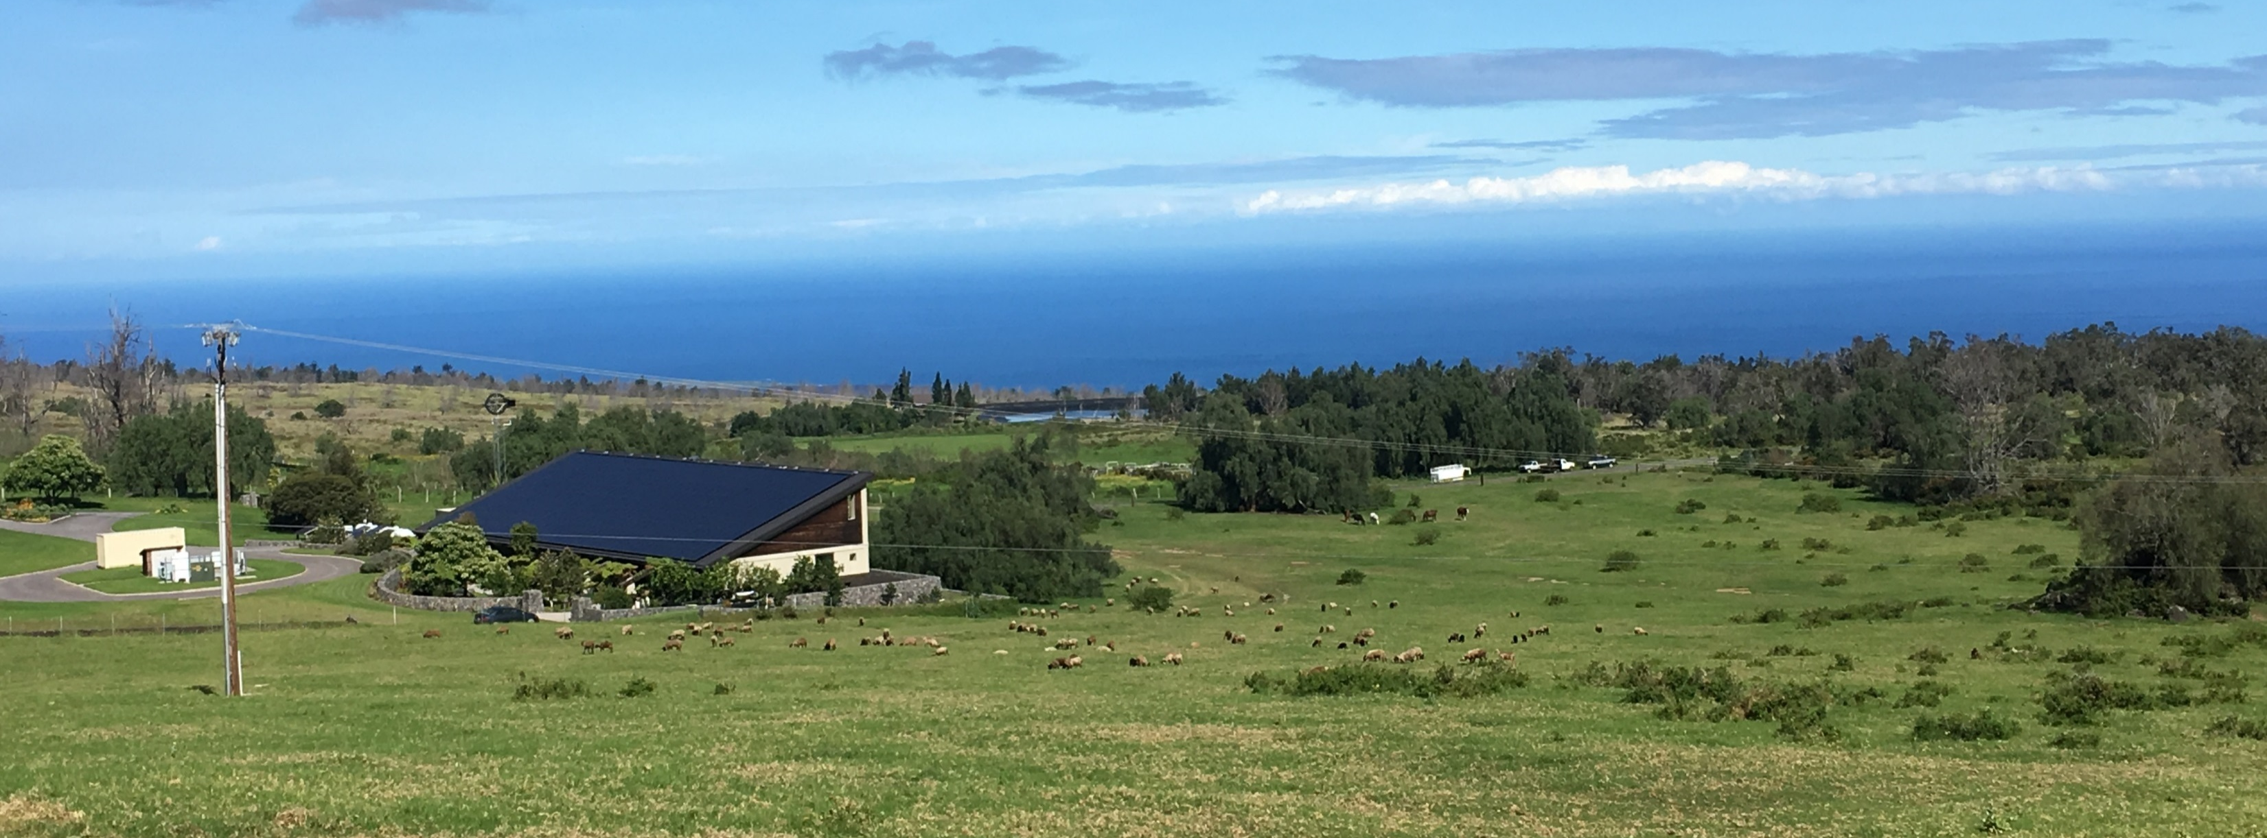
Pu‘u Wa‘awa‘a and Pu‘u Anahulu
HCP Game Mammal Management Update

