Slide 1
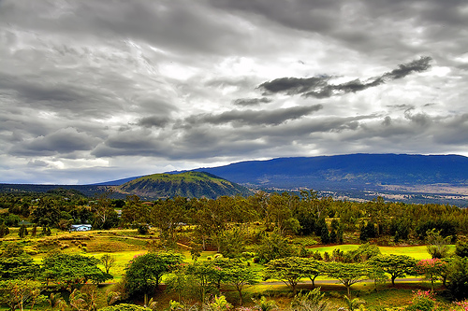
Fire Suppression Strategies at Pu‘u Wa‘awa‘a and Pu‘u Anahulu

Slide 2
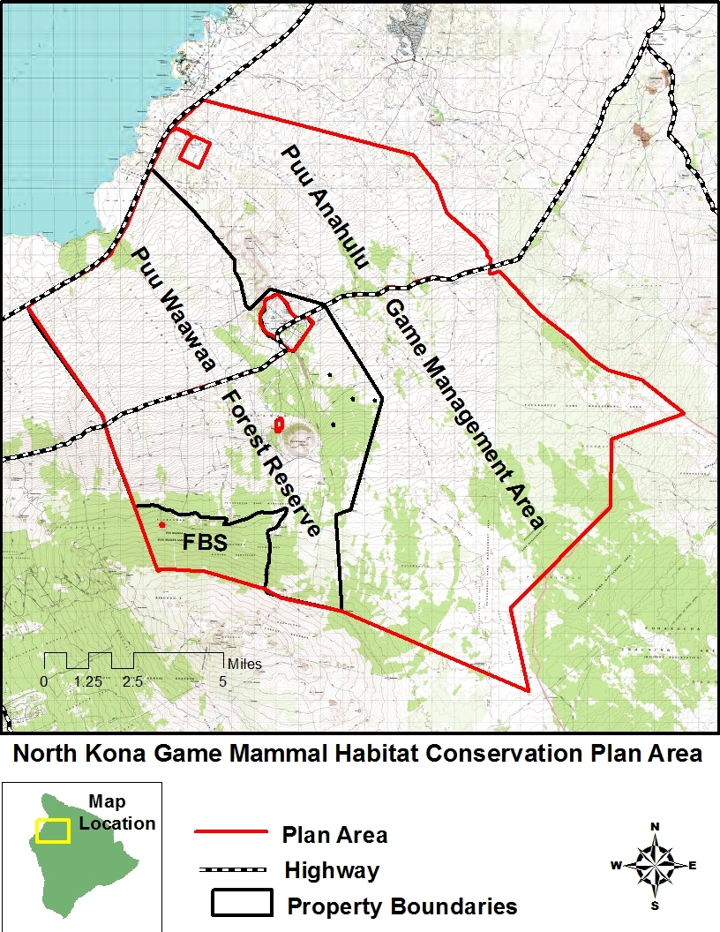
Overview
History
Effects of Fire: Case Study
Literature Review
Current Strategies

Slide 3
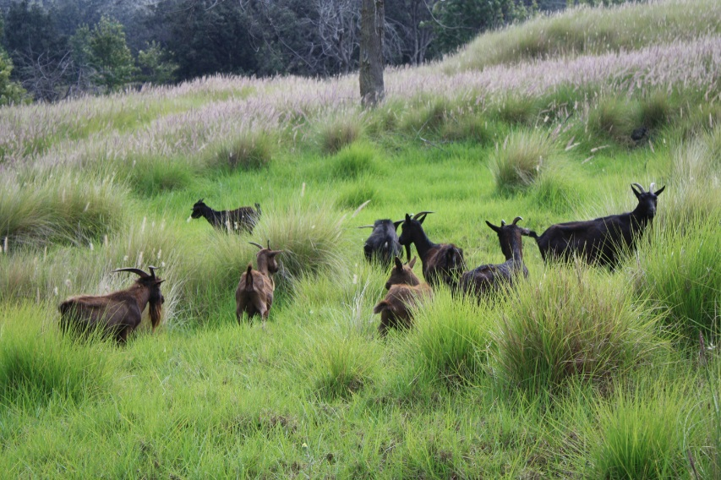
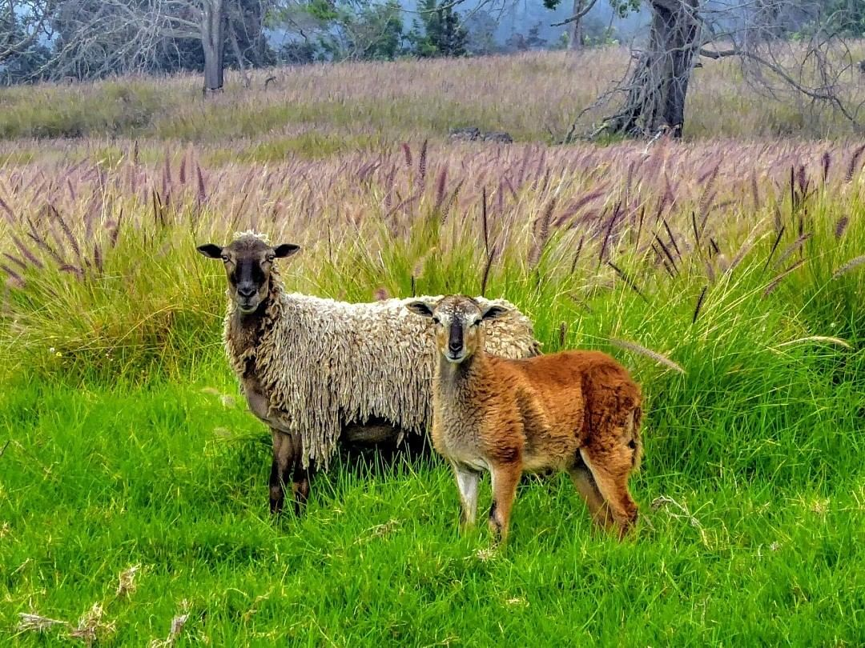
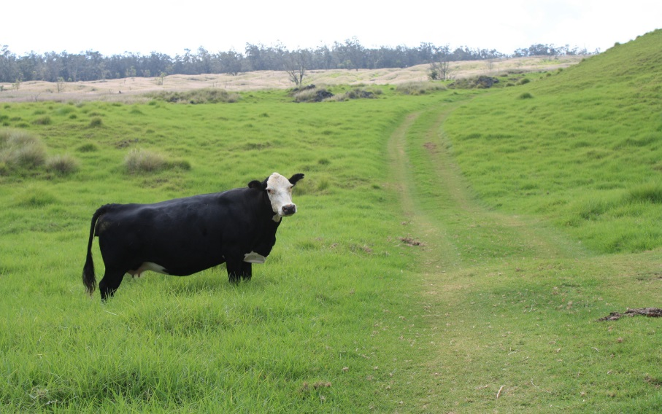
Introduction and History
1860’s - 1960:Various goat, sheep, and cattle grazing in Pu‘u Wa‘awa‘a, cattle grazing in Pu‘u Anahulu
1960: 40 year cattle grazing lease signed to Dillingham Ranch, Inc. for 105,000 acres
1972: Lease signed over to F. Newell Bohnett
1984: 84,000 acres in Pu‘u Anahulu and part of Pu‘u Wa‘awa‘a revoked due to illegal koa harvesting,
3,806 acres of this set aside to be made into a Forest Bird Sanctuary.
2000: Bohnett lease ends

Slide 4
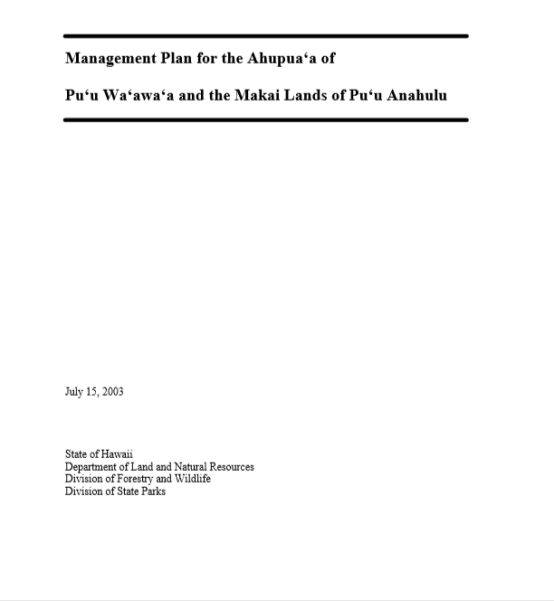
Introduction and History
2002: Lands are transferred over to DOFAW and State Parks
Pu‘u Wa‘awa‘a Advisory Council is formed
Executive Order creating Pu‘u Wa‘awa‘a Forest Bird Sanctuary signed
2005: Draft Pu‘u Wa‘awa‘a Management Plan approved in concept by the BLNR
2006: Executive Order transferring Pu‘u Anahulu to DOFAW and creating a GMA signed

Slide 5
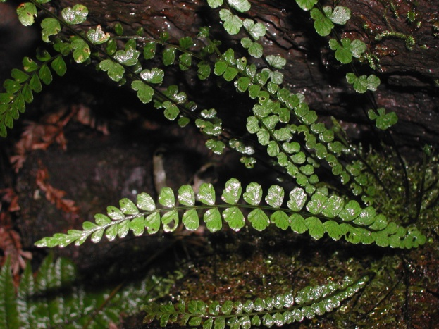
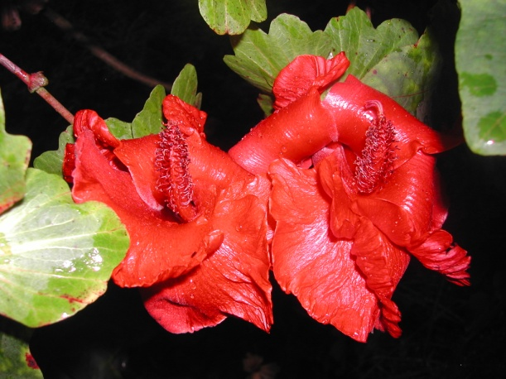
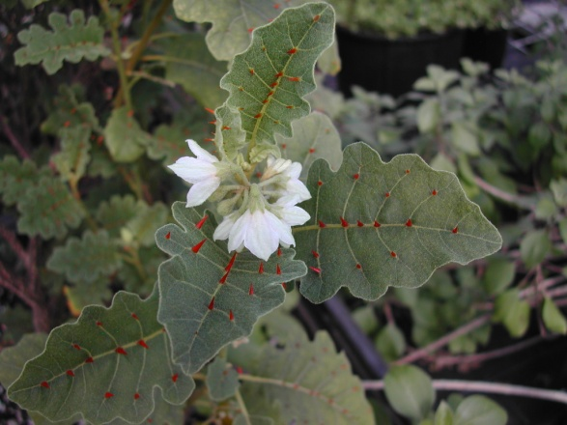
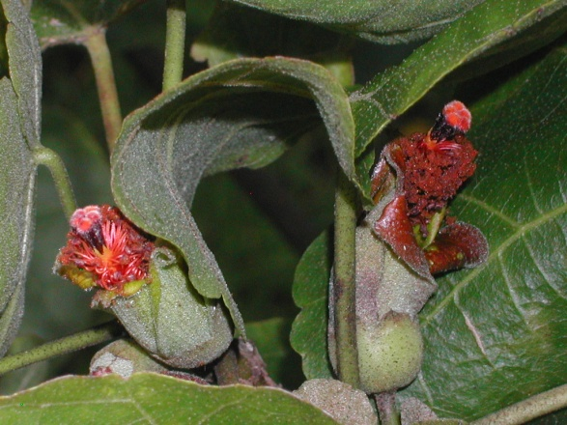
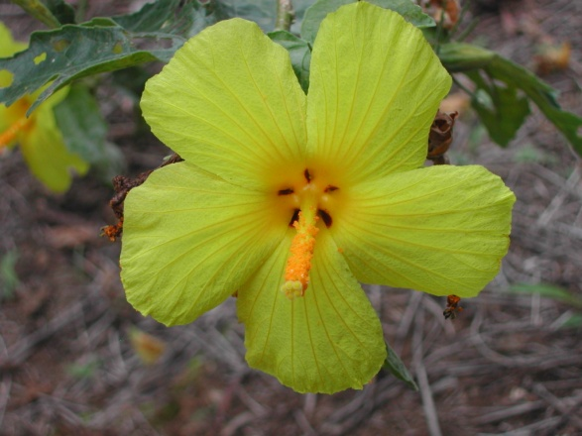
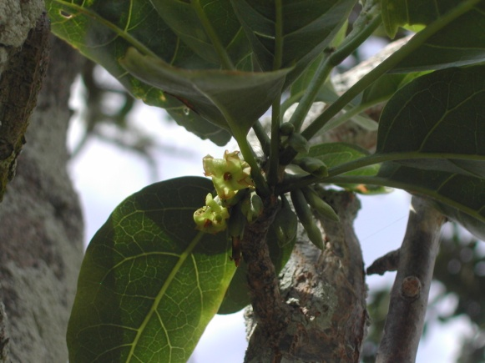
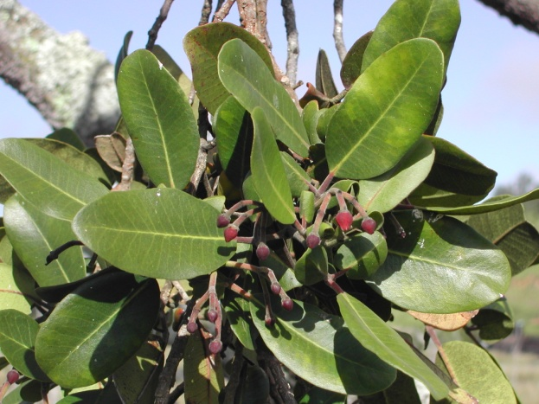
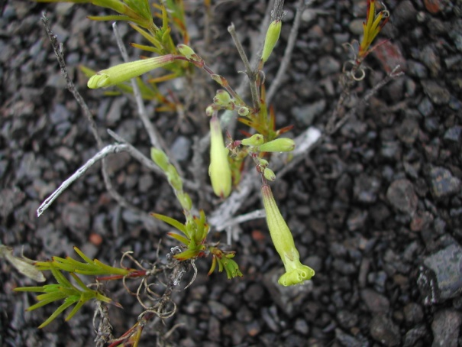
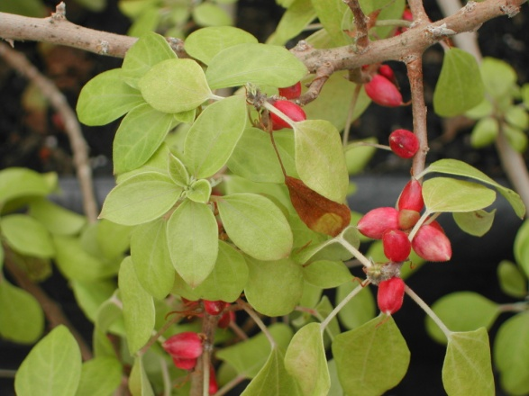
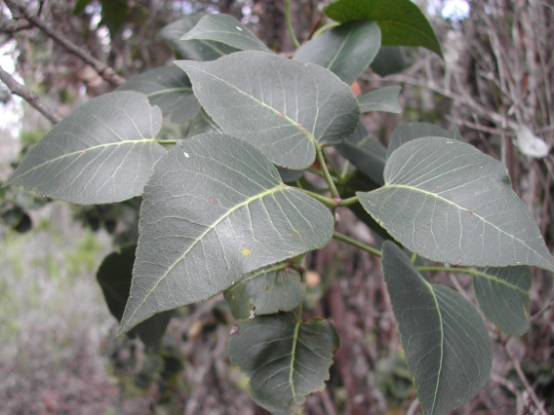
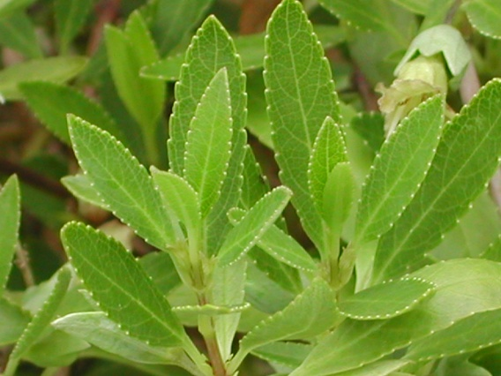
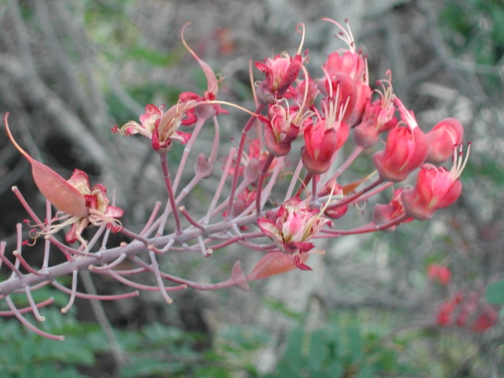
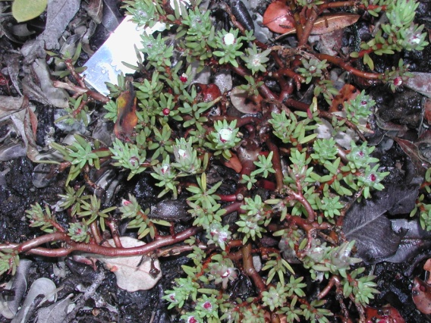
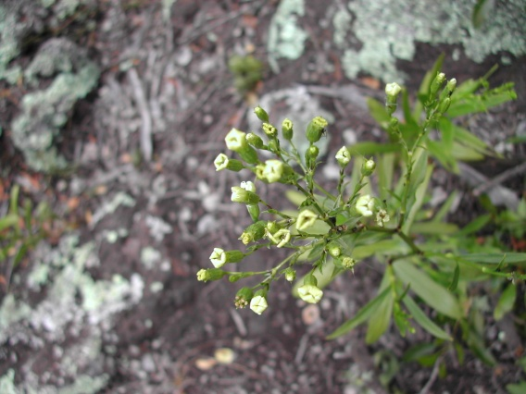
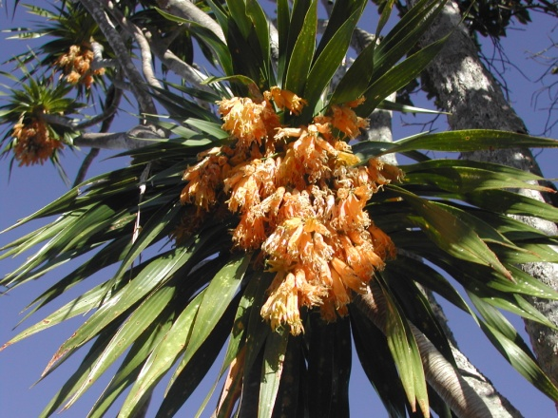
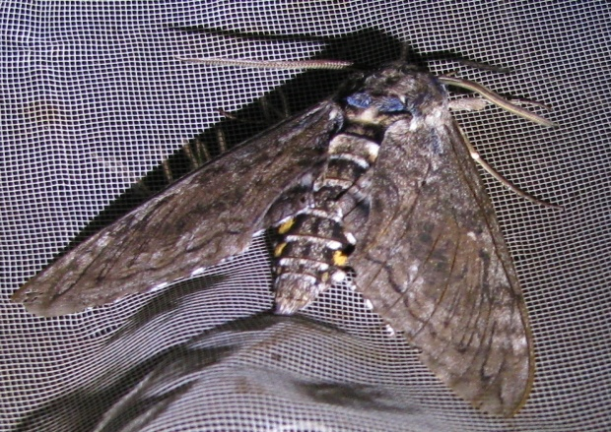
Covered Species
Protect and restore native habitat for the survival and recovery of 15 endangered plant species and 1 endangered moth.

Slide 6
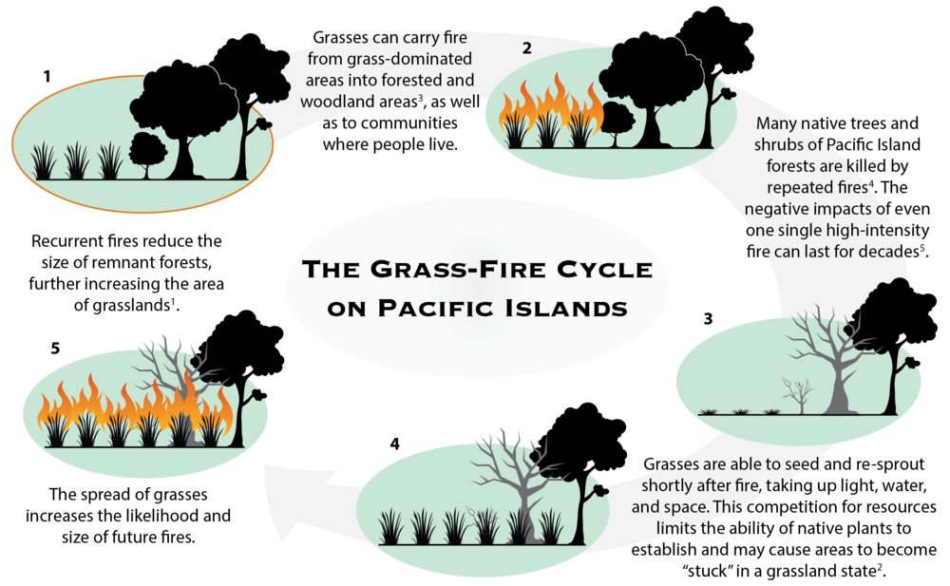

Slide 7
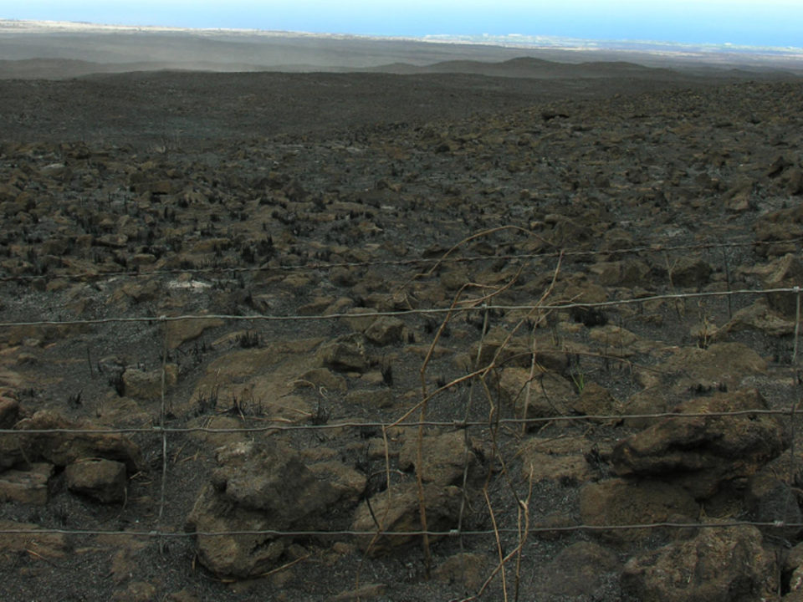

Slide 8
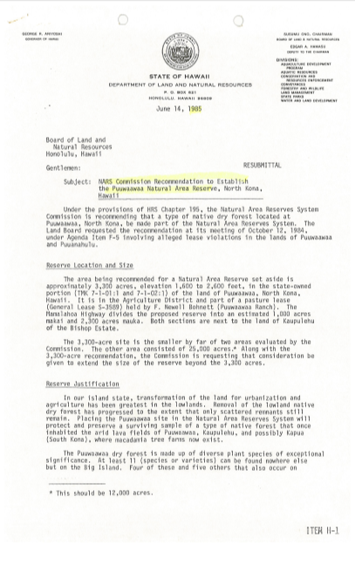
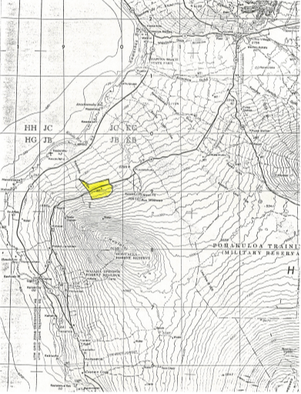
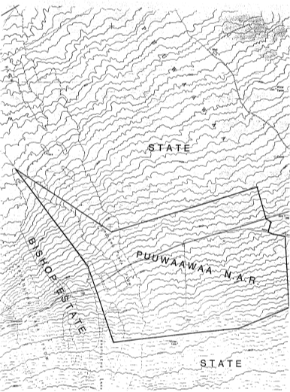
Effects of Fire: Case Study

Slide 9
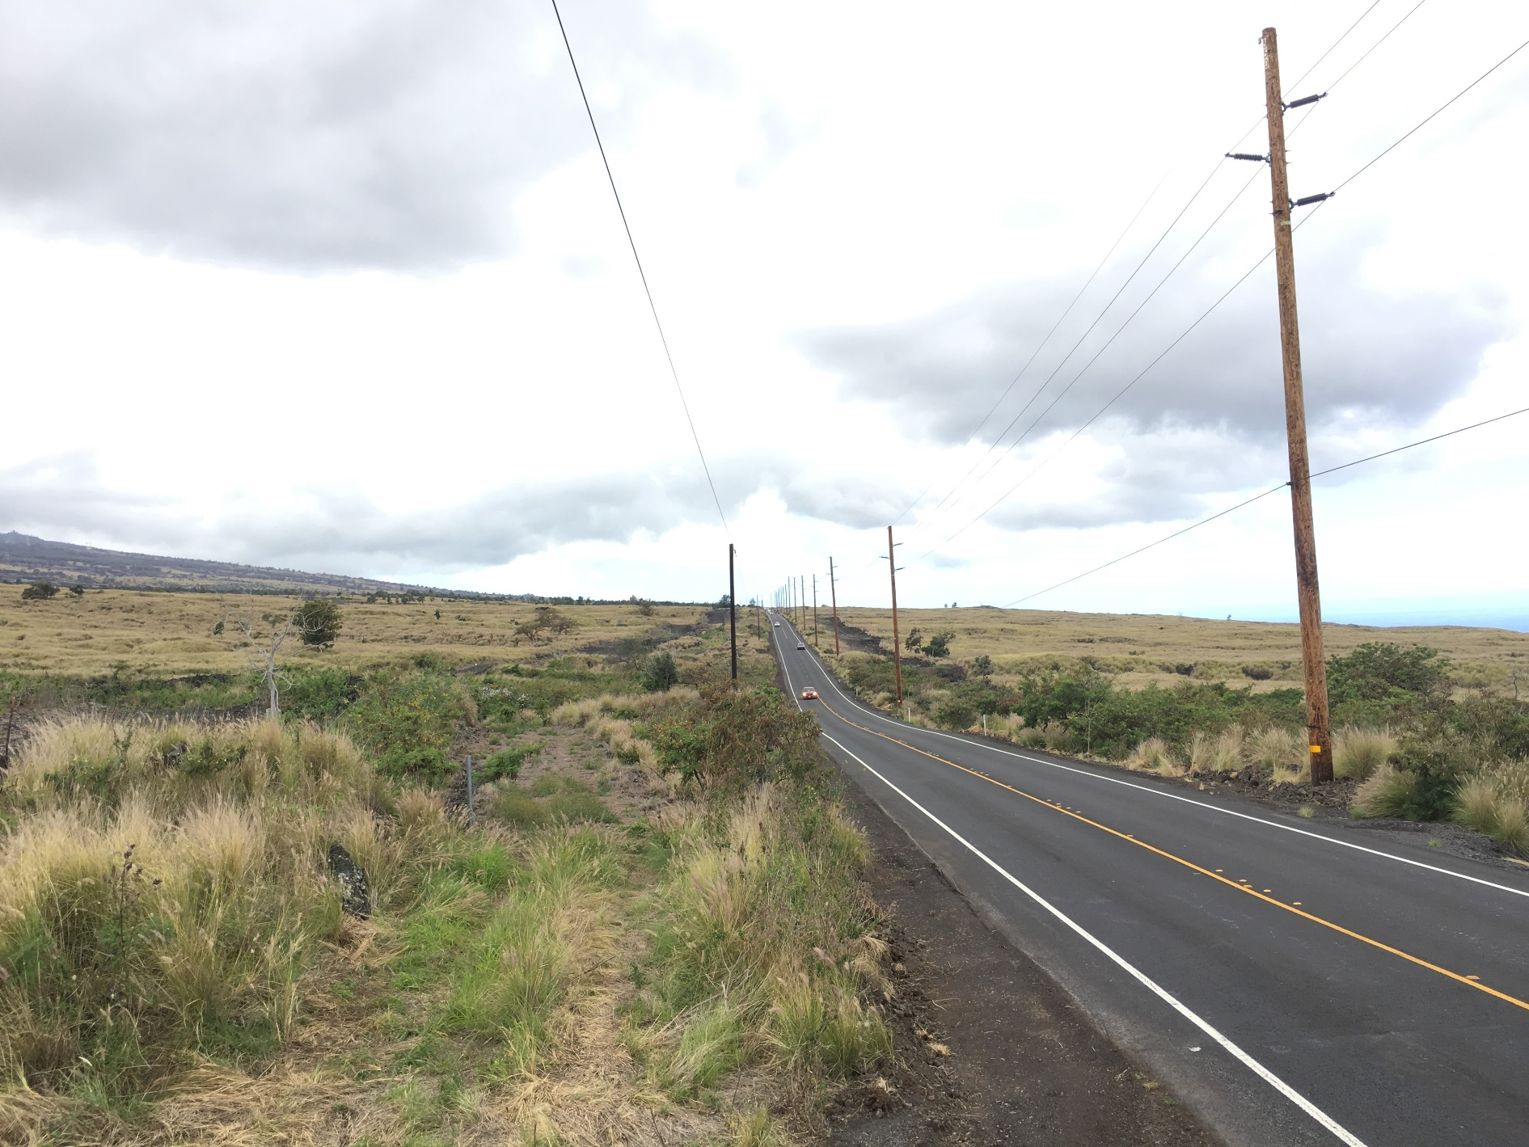
Effects of Fire: Case Study
1985 Proposed NAR
2019

Slide 10
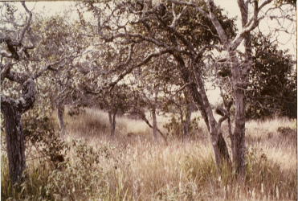
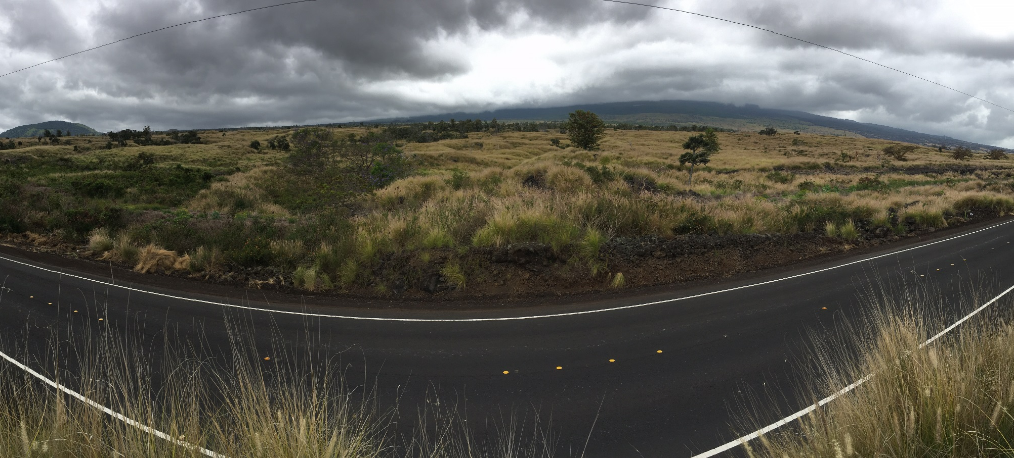
Effects of Fire: Case Study
1985 Proposed NAR (Mauka)
2019 (Mauka)

Slide 11
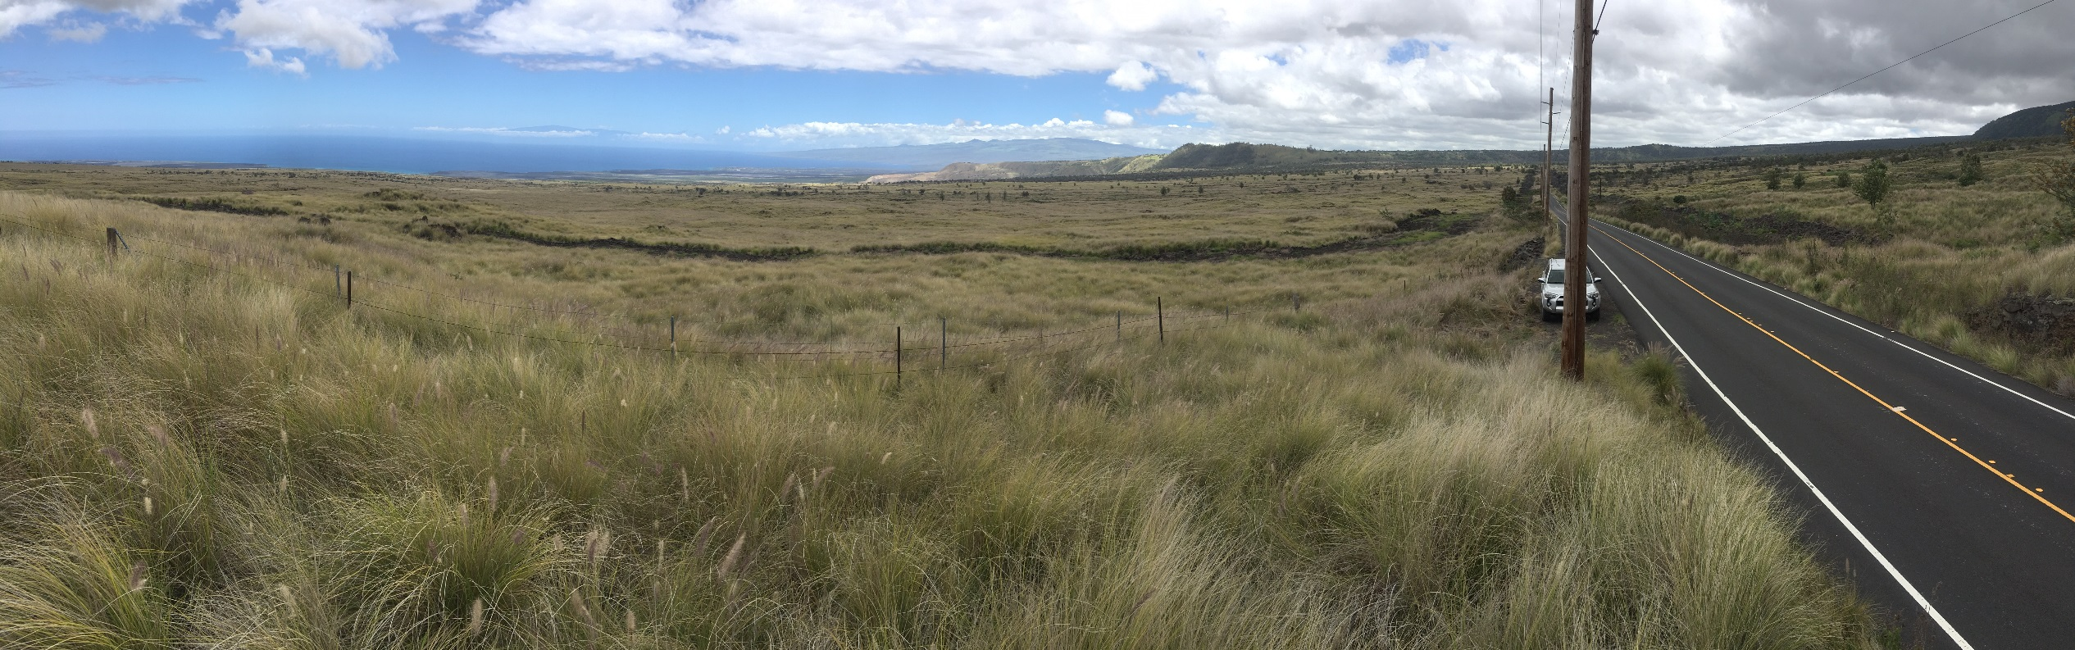
Effects of Fire: Case Study
1985 Proposed NAR (Makai)
2019 (Makai)

Slide 12
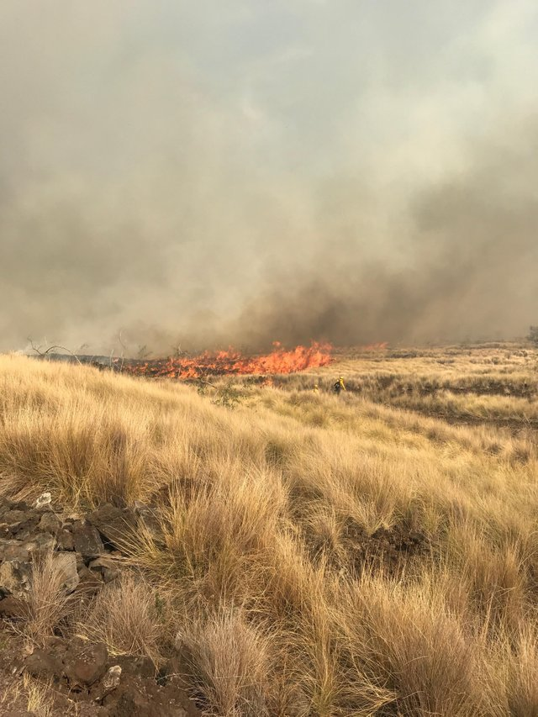
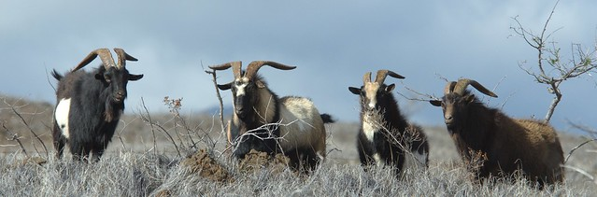
Literature Review
“Even as grazing causes gradual declines in forest cover, however, it protects forests from rapid loss to destructive fires by reducing the ability of grass fuels to carry fire.
Grazing in drier areas reduces the risk of fire not only by controlling the accumulation of fuels, but also by controlling the spread of more flammable grass species.” (i.e. fountain grass)
Blackmore and Vitousek 2000

Slide 13
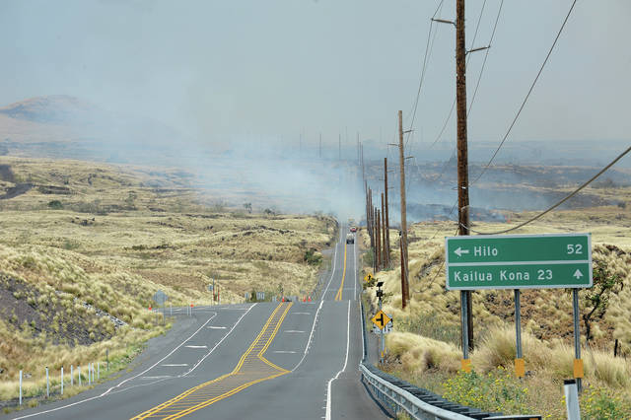
Literature Review
Manual control of invasive grasses would cost ~$4.6 million annually at Pu‘u Wa‘awa‘a
- Wada et. al. 2017
Estimating Cost-Effectiveness of Hawaiian Dry Forest Restoration Using Spatial Changes in Water Yield and Landscape Flammability under Climate Change

Slide 14
Literature Review
Livestock grazing, when proper stocking rates are implemented, is a cost-effective tool for fuel load management in Pu‘u Anahulu
Castillo et. al. 2007
Effects of Cattle Grazing, Glyphosate, and Prescribed Burning on Fountaingrass Fuel Loading in Hawaii

Slide 15
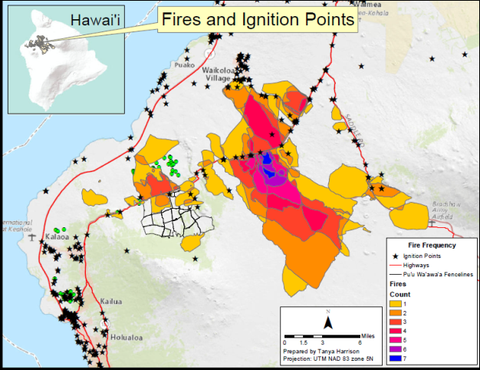
THREAT: Fire
Mitigation: Cattle/Ungulate Grazing
Cattle Grazing: DOFAW issues 3 annual grazing permits in PWW for fuel control. In the circled area there are currently ~1,000 head of cattle. We are exploring the possibility of moving cattle into Puu Anahulu and implementing proper stocking rates in PWW Makai. Completed a $5 million water improvement CIP project which will help us increase the stocking rate below the highway.

Slide 16
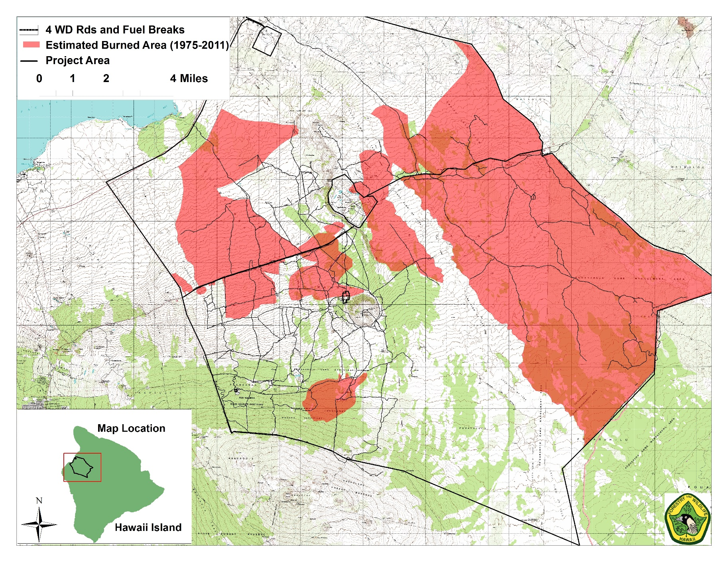
THREAT: Fire

Slide 17
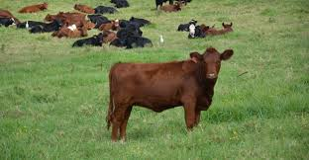
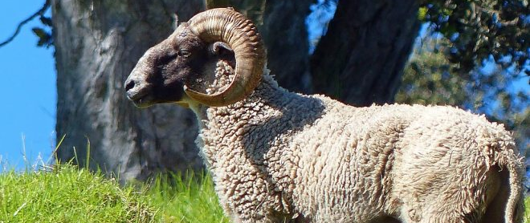
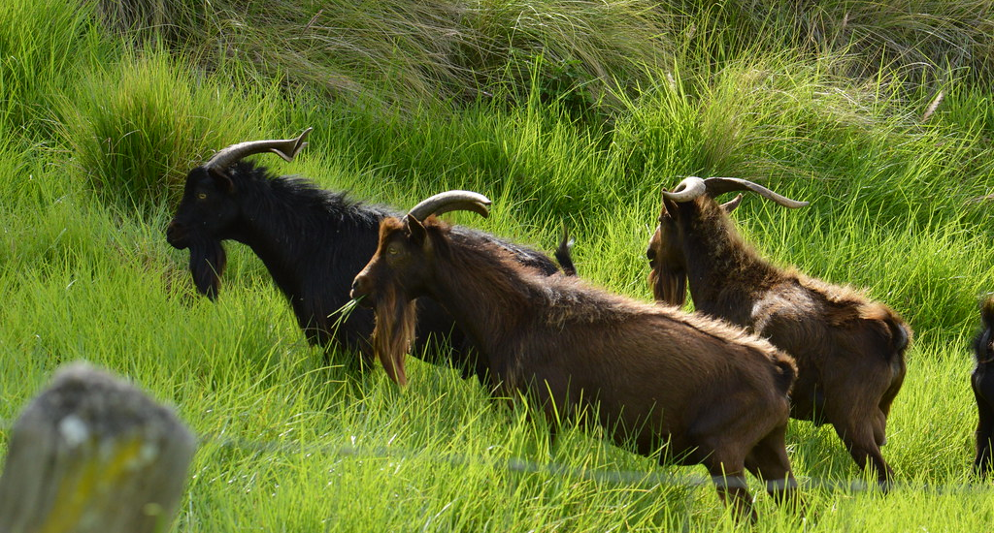
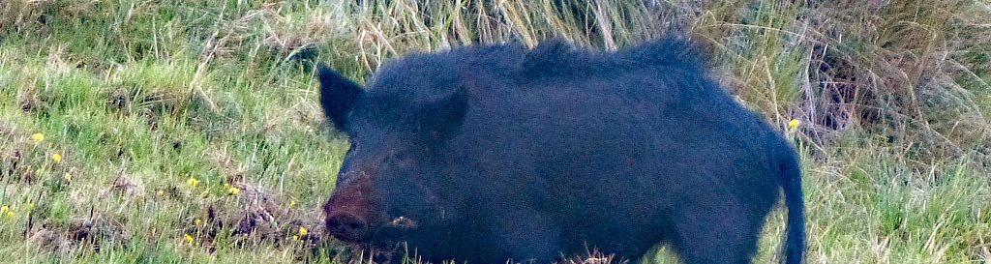
Current Strategies: Ungulate Removal

Slide 18
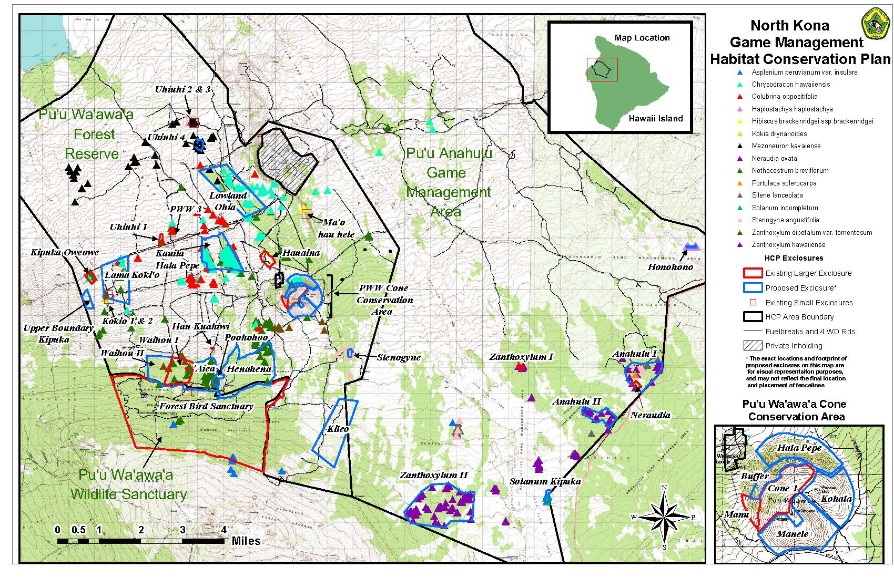
Current Strategies: Ungulate Removal
Fence ~8,000 acres of native forest (~50% of remaining native habitat). 80% of the known endangered plants are located in these fences. Remove all ungulates from within the fences.
Mitigation for endangered plants taken outside of fences through outplanting and habitat restoration.

Slide 19
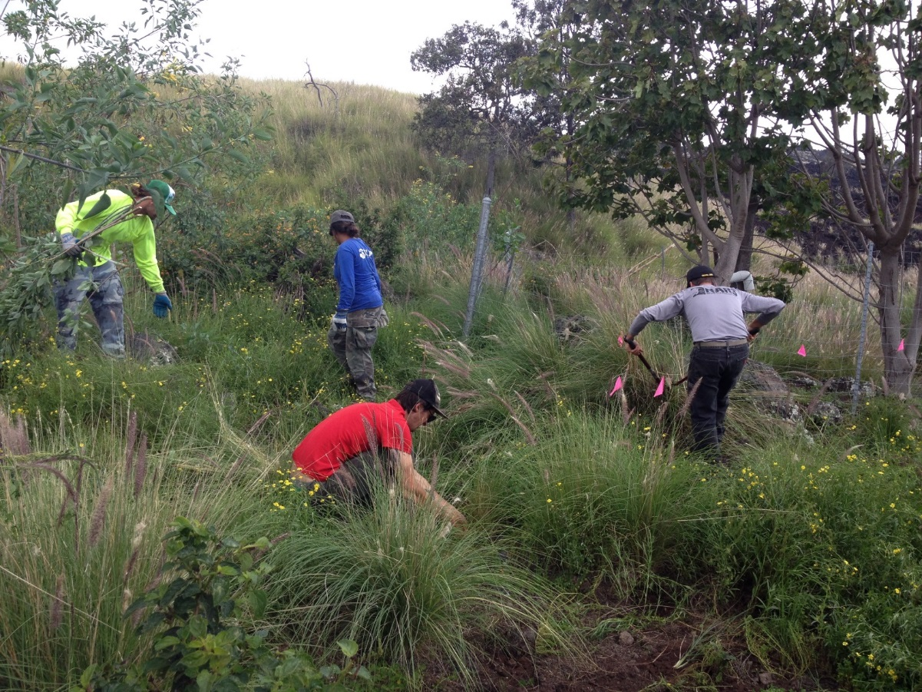
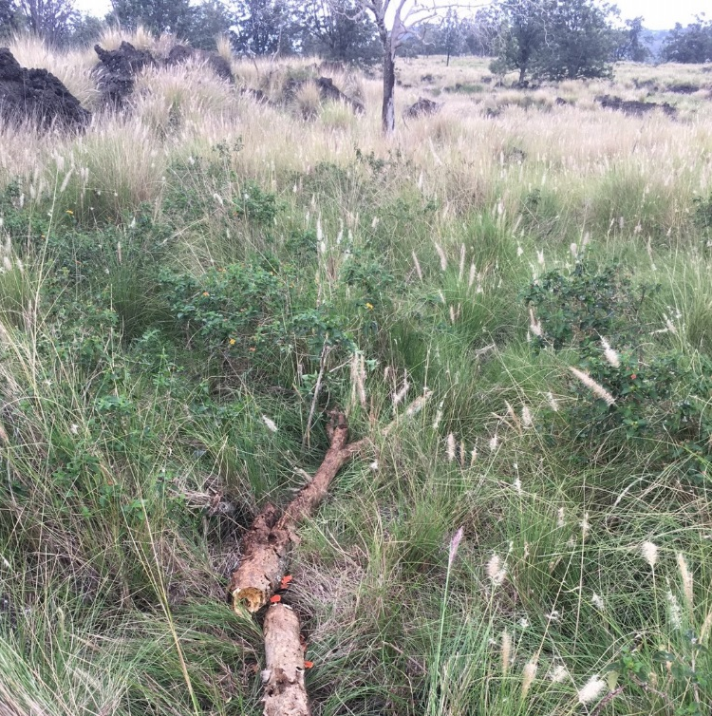
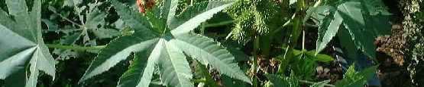
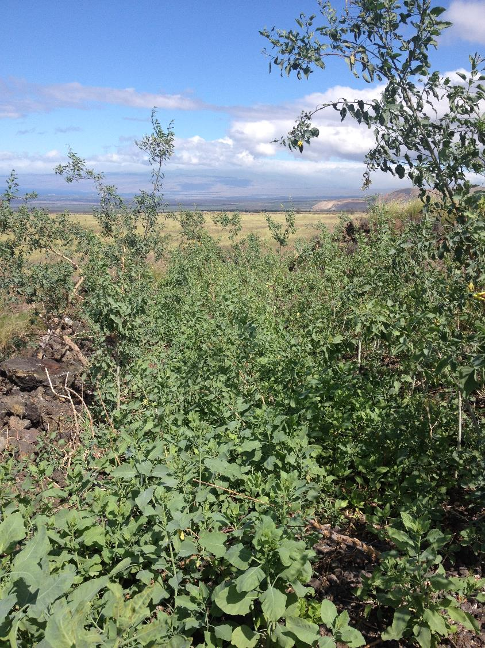
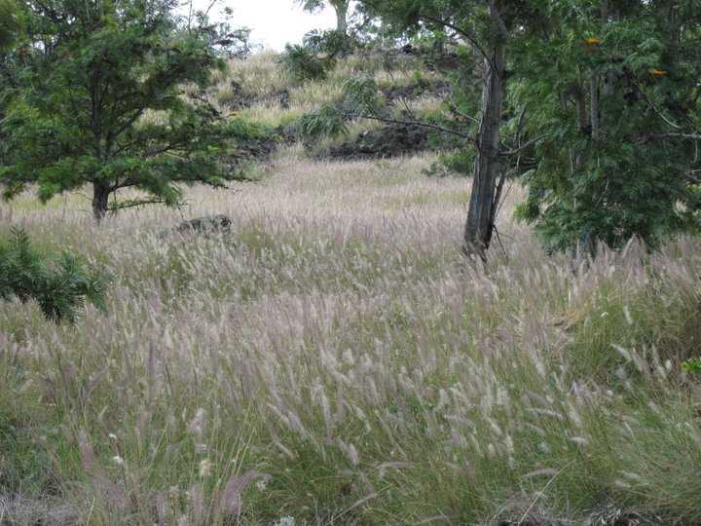
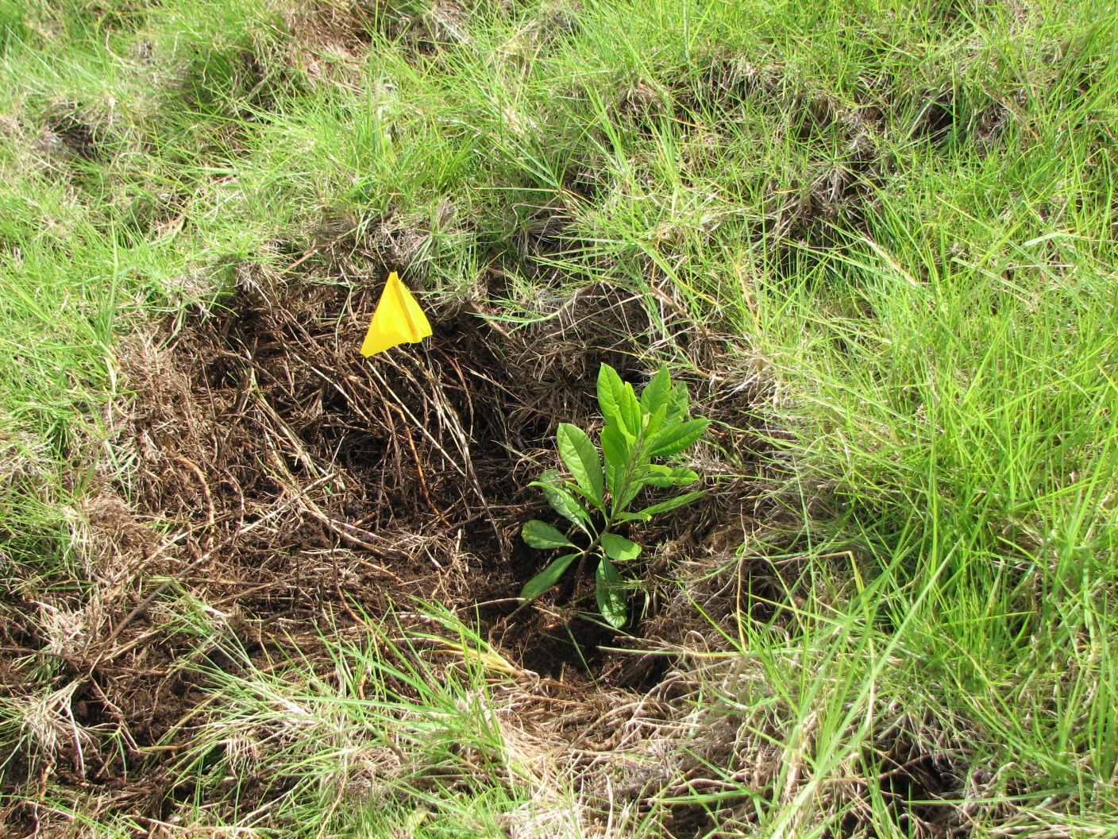
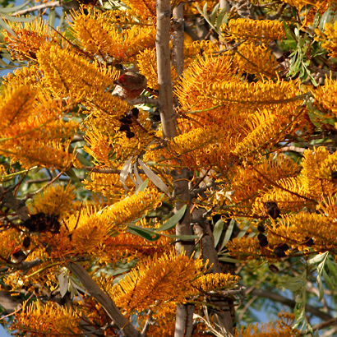
Current Strategies: Weed Control Removal

Slide 20
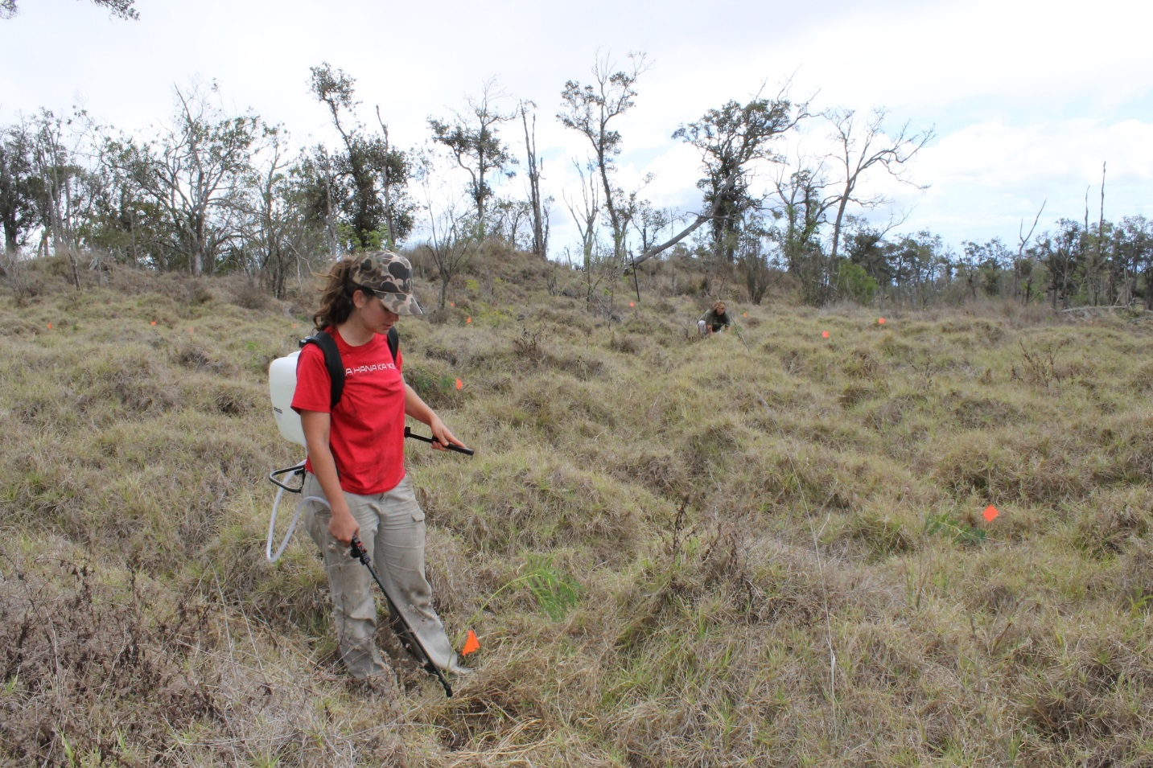
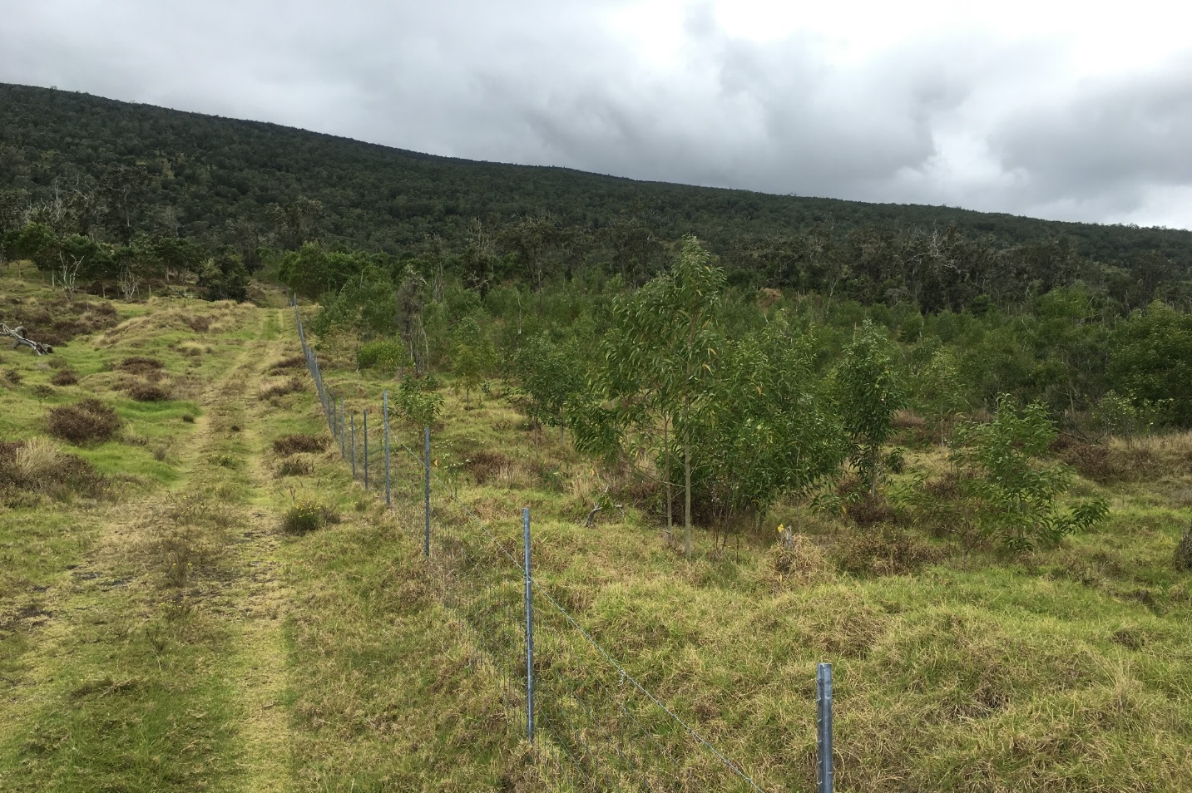
Current Strategies: Weed Control Removal

Slide 21

Mahalo!

