Slide 1

  J. B. Friday
  University of Hawai‘i Cooperative Extension Service
  EMAIL: jbfriday@hawaii.edu; PHONE: 808-969-8254
  Hawai‘i County Game Management Advisory Commission
  July 2, 2018
Notes:
This is a set of slides that you can use to design talks for different audiences. Each audience may need different information: some are more technical, some are more familiar with Hawaii conservation and natural history. Figure on 45 slides = a one hour talk, 15 slides = a 20 min talk.
I have added notes to each slide. These are just notes for you to understand; they are not designed to be read aloud as a narration for a slide show.
Each of the people mentioned contributed photographs and information. Anya Tagawa (DOFAW Hawaii Branch) did the graphics.
Most of the text is mine. J. B. Friday, Extension Forester, University of Hawaii Cooperative Extension Service, jbfriday@hawaii.edu

Slide 2
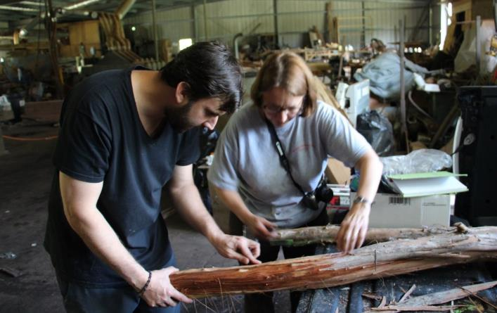
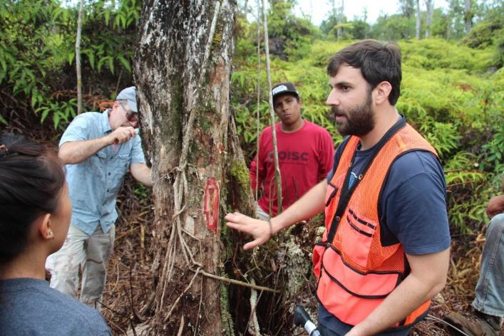

ROD is two new diseases
Jenny Juzwik, USDA Forest Service
Marc Hughes, UH Mānoa CTAHR
Lisa Keith, USDA Ag Research Service
Eva Brill, USDA Ag Research Service
Ceratocystis lukuohia:
‘Ōhi‘a wilt: more aggressive pathogen 95% of the mortality
Ceratocystis huliohia:
‘Ōhi‘a canker: may have been in Hawai‘i longer
Notes:
Our researchers have found that the two species causing Rapid ʻŌhiʻa Death (ROD) symptoms act very differently within a tree. Ceratocystis lukuohia (formerly species A) spreads rapidly – a few feet a day - throughout an infected tree and is referred to as ʻōhiʻa vascular wilt. Its spores move in the flowing sap in the sapwood. Ceratocystis huliohia (formerly species B) spreads slowly – a few inches a day - and creates dead tissue (necrosis) in a limited area around the infection point, referred to as a canker. It only moves by growing mycelia through the sapwood. Research on these species is ongoing.
Although there are now two new species, for management purposes we are treating them the same and still calling the disease Rapid Ohia Death.

Slide 3
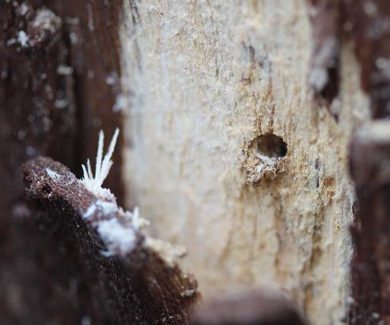
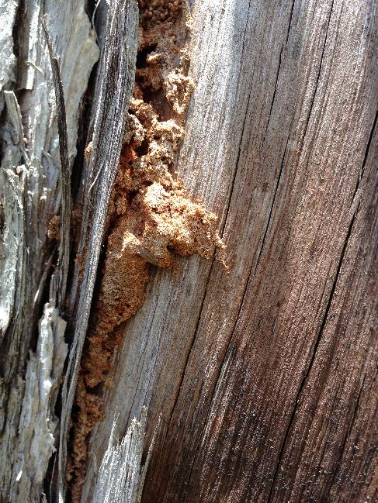
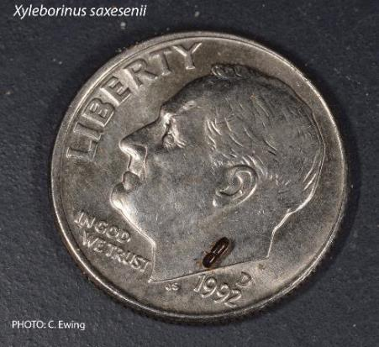
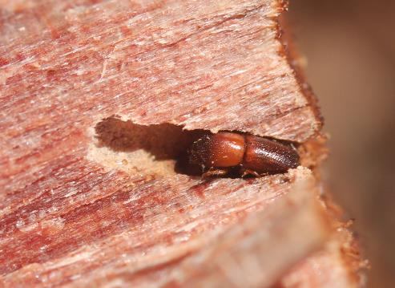
How does ROD move?
Ambrosia beetles & wind spread contaminated frass
Beetles are attracted to wounded or dead ‘ōhi‘a
Notes:
Ambrosia beetles live by boring into wood / trees and culturing a fungus, which they eat ( called ambrosia). They do not culture Ceratocystis; they just sense stressed trees and bore into them. In the process their tunneling releases a lot of fine sawdust that can blow in the wind. Must of the sawdust (frass) contains Ceratocystis spores.

Slide 4
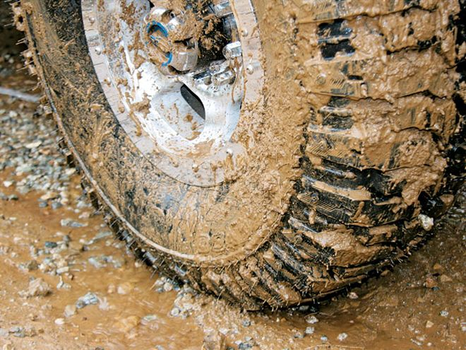
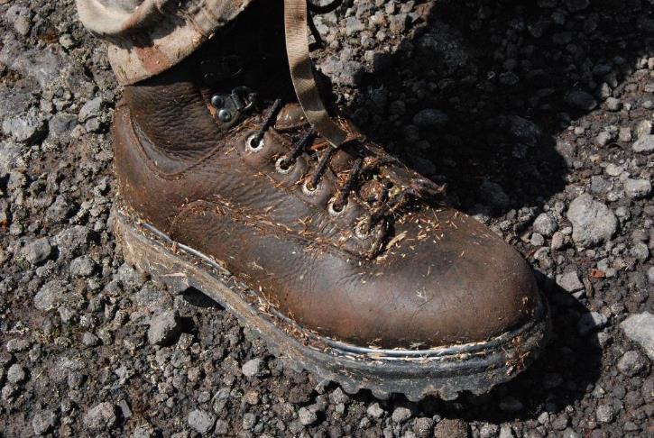
How does ROD move?
Contaminated soil in infected stands leads to contaminated shoes and vehicles
Notes:
When infected sawdust (frass) lands on the soil, the soil will be infected. Researchers found that 5% of the soil from infected stands tested positive for the Ceratocystis. If you walk or drive through infected ares, you risk spreading the fungus in the soil on your boots or tires. Only if you pick up soil. You won’t pick up the fungus on pavement, at least not to a significant amount.

Slide 5
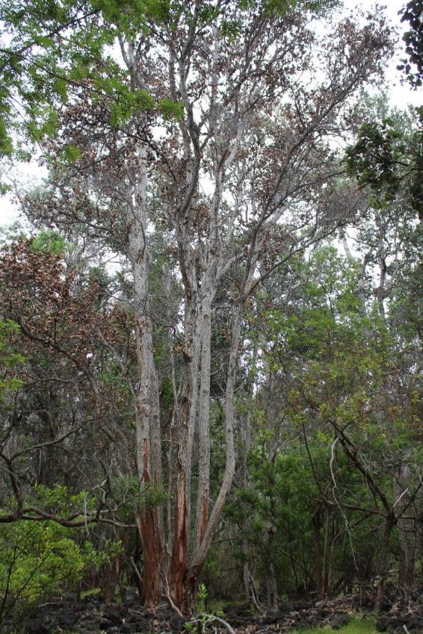
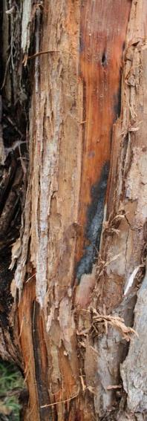

Wounds As Infection Sites
Wounded trees confirmed to be infected with Ceratocystis
Livestock peeling bark: photo by Wade Heller
Notes:
We continue to see strong associations between wounding events and the development of ROD
This shows a stand of ohia in Ka’u growing on lava where there was no grass. Feral animals, either goats or cattle, were stripping bark. We could see the fungus growing on the wood surfaces from which the bark had been peeled. Many of the injured trees were infected by Ceratocystis (lukuohia in this case).

Slide 6
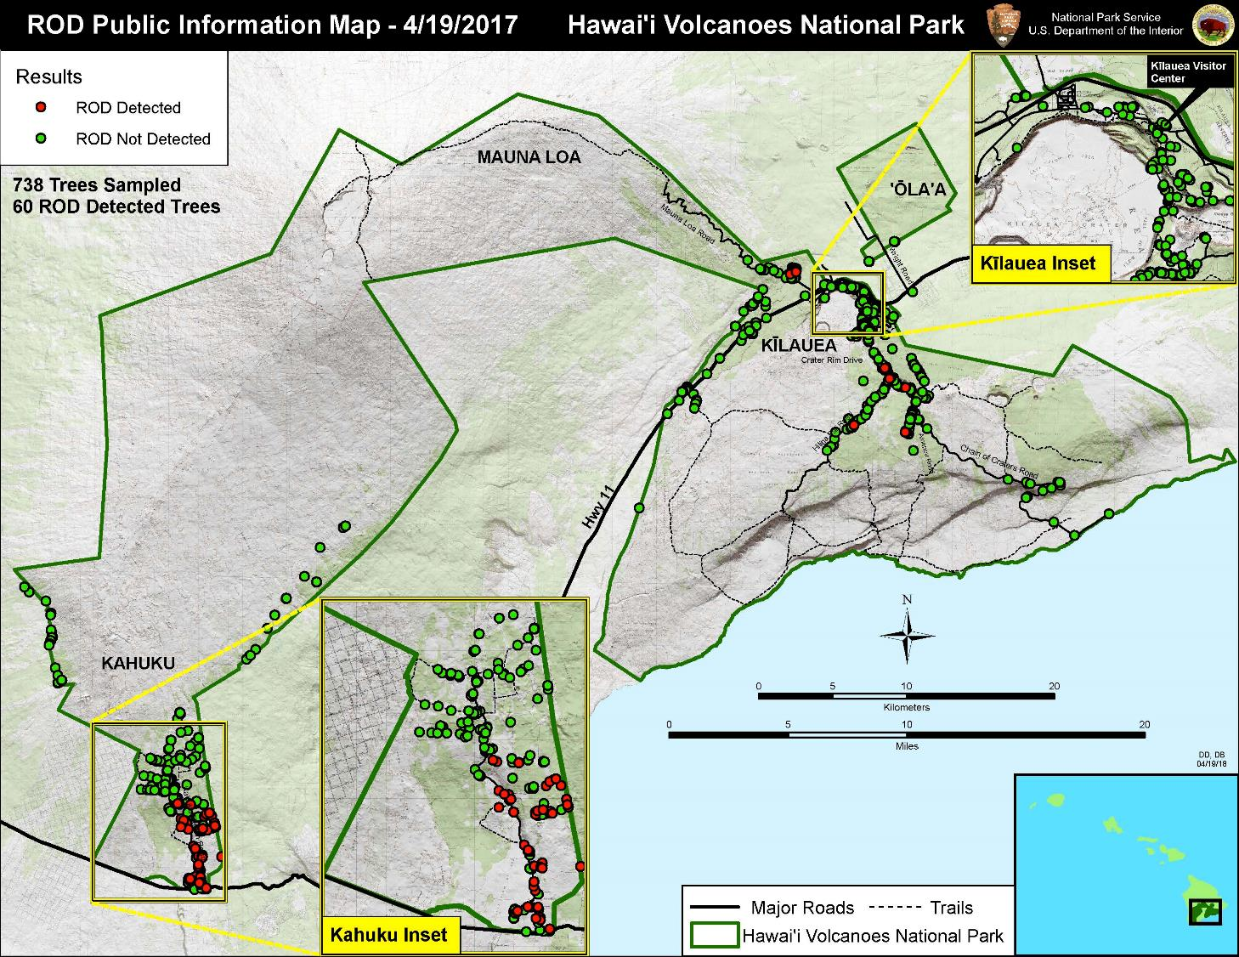
Fence line
Notes:
One of the major ways trees get wounded is by feral grazing animals that peel the bark off trees. Cattle and goats and sheep are prone to do this. We have now seen several examples of areas where ROD is prevalent in areas where there are lots of feral animals but little or no ROD in fenced areas next door where feral animals have been kept out.
The map is a map from Hawaii volcanoes National Park showing ROD detections (red circles) and ROD samples where ROD was not detected. Most of the detections in the park are in the Kahuku unit (lower inset). All but one detection were below the fence line that runs across the unit. There is a population of mouflon sheep below the fence line but almost none above the fence line. The fence was put in 5 or 6 years ago.

Slide 7
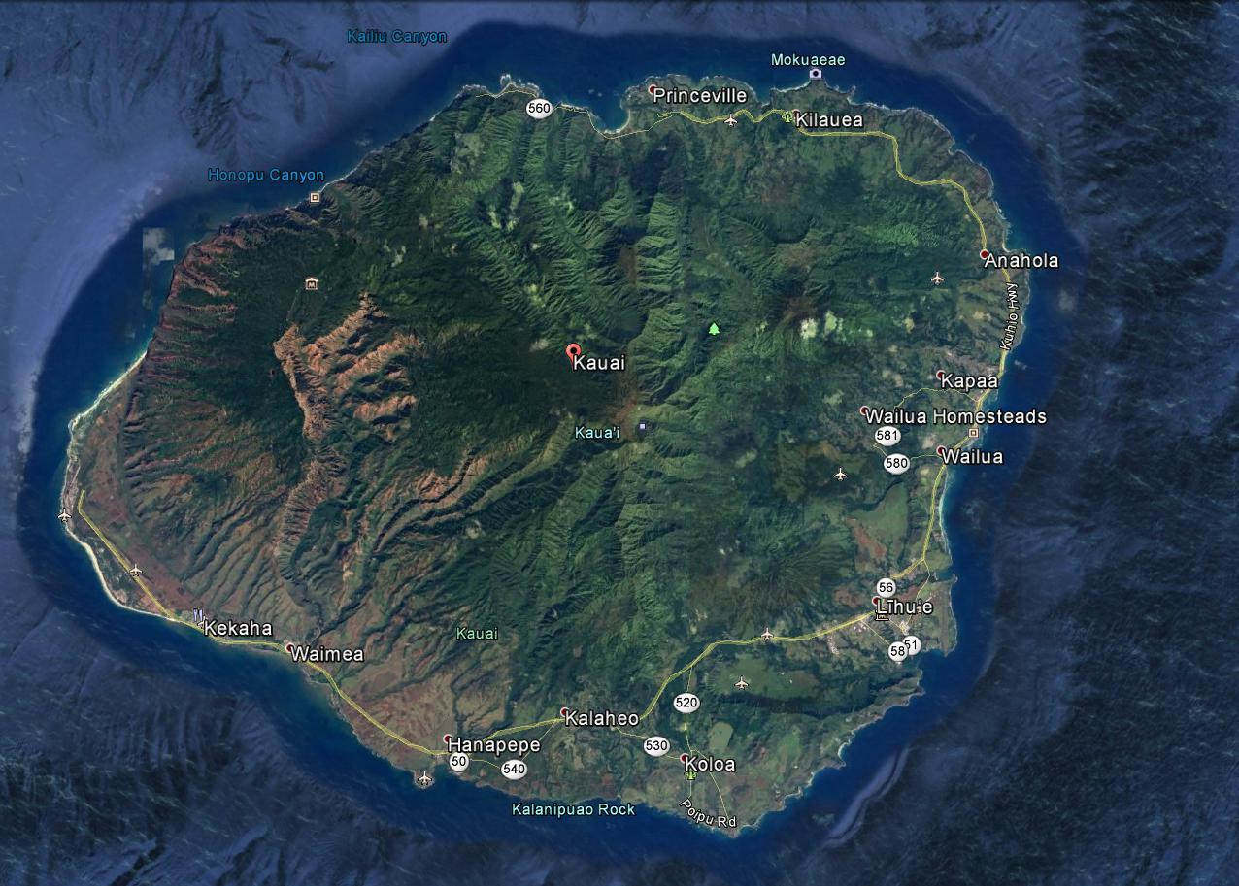
Kaua‘i
Detection
May 2018
15 trees sampled
8 positive for
Ceratocystis hulioha
(formerly species B)
Notes:
In early 2018 foresters on Kauai noticed some trees with ROD-like symptoms. In May 2018 a crew took samples and the molecular test found DNA of Ceratocystis huliohia, the species formerly called “species B.” This is the less aggressive of the two species of Ceratocystis that cause ROD and probably accounts for less than 10% of the mortality on Hawaii Island. It causes ohia canker, not ohia wilt. Nonetheless it is a huge concern for Kauai. We do not know how the disease got there. We do not know how long it may have been on Kauai. Right now (May 2018) staff is conducting aerial surveys both by aerial sketch mapping from helicopters and from drones to determine the extent of diseased trees. Individual trees showing samples will then be sampled. When the extent of the disease is known then preventative measures can be taken. If the disease is spread over a large area, that would indicate that the disease has been on Kauai for a long time. The disease has been on Kauai for at least a year, judging form how long some of the affected trees seem to have been dead.
The biologists are also looking to see if the can detect small differences in the DNA between Ceratocystis huliohia populations on Hawaii Island and Ceratocystis huliohia populations on Kauai. If they find any that would be an indication that the disease has been on Kauai for a long time.
Right now recommendations are the same: Clean boots and tooks and vehicles and gear. Don’t move ohia. Don’t wound ohia. Ceratocystis huliohia is a wound pathogen that needs a wound to get into the tree.

Slide 8
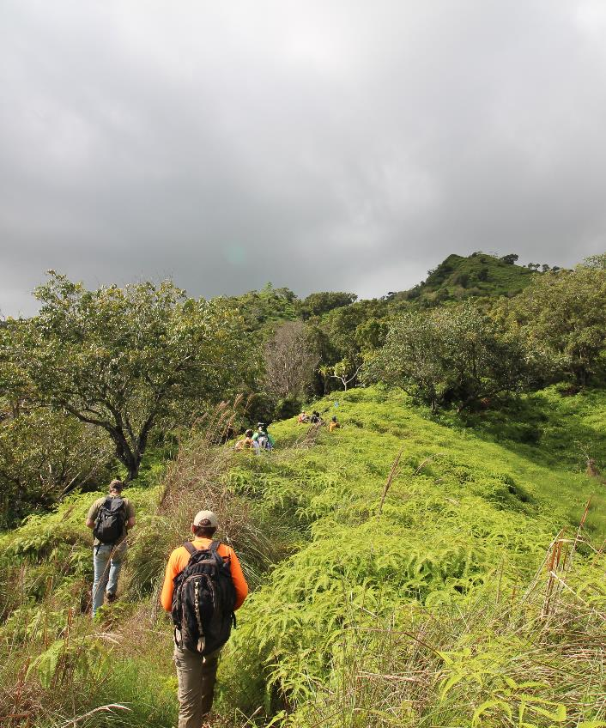
Kaua‘i Detection
Detected by a hunter
Not sure how widespread the infection is
Not sure how long Ceratocystis huliohia has been on Kaua‘i
Next steps:
  Helicopter surveys
  Drone surveys
  Field sampling
Notes:
The Kauai detection has initially been on only a few trees in one area, but initial drone flights over the area are finding more symptomatic trees that need to be tested. Helicopter flights and aerial sketch mapping will be used to delineate the extent of the infestation.

Slide 9
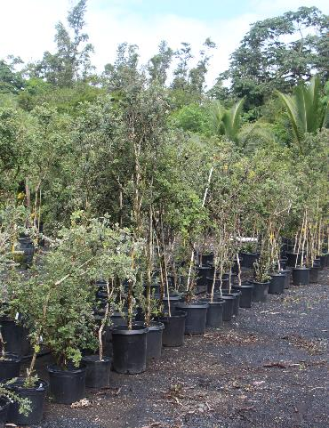
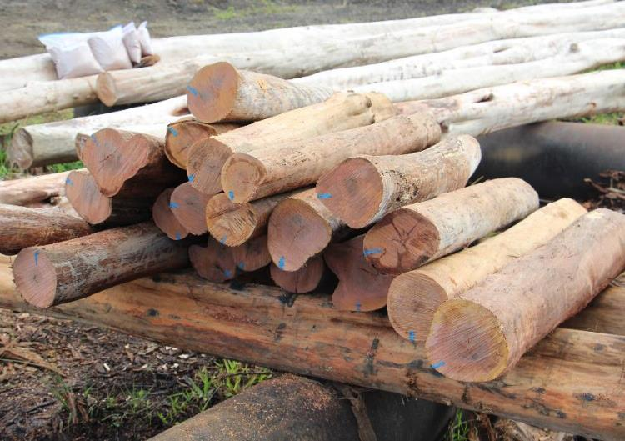
How do we protect remaining healthy ‘ōhi‘a forests?
Don’t move ‘ōhi‘a wood, posts, or plants
Notes:
Moving around plants or wood (posts, firewood) that is infected with Certaocystis is a very good way to move the disease around. Please don’t do it.

Slide 10
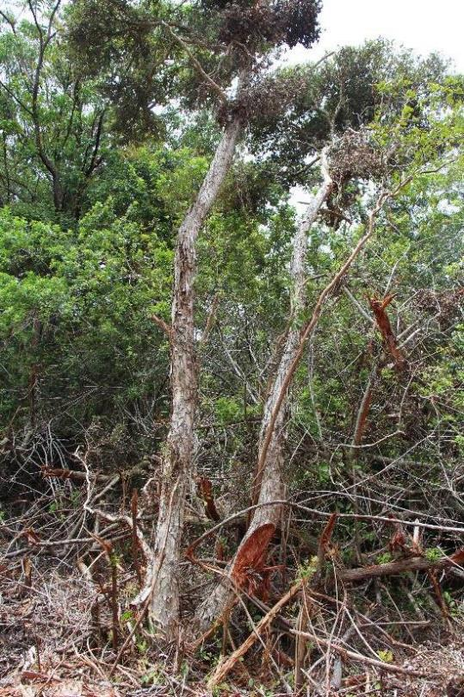
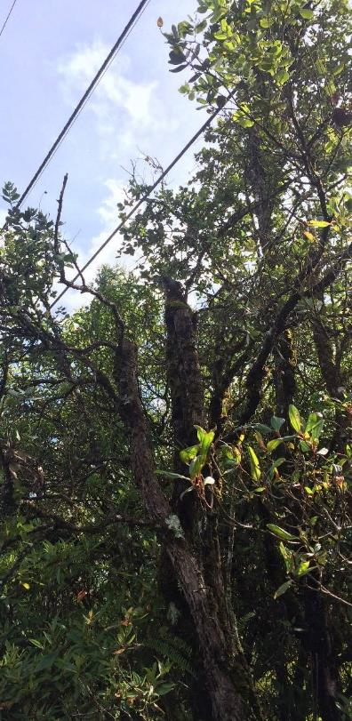
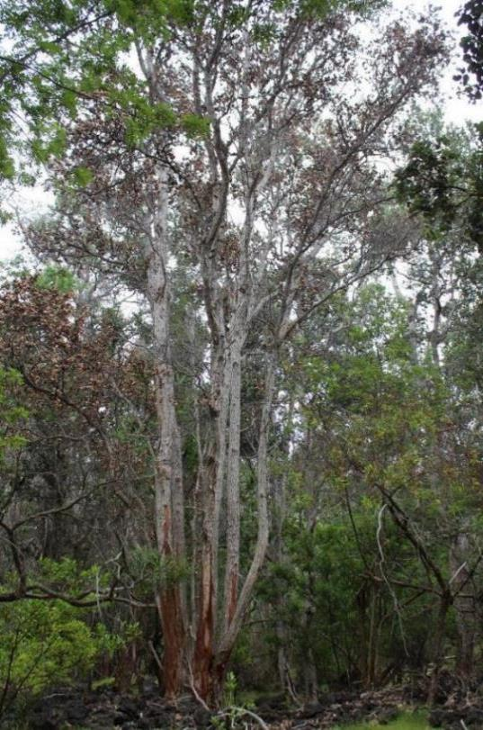
Don’t wound ‘ōhi‘a trees
Heavy equipment
Poor pruning
Livestock
Notes:
We know that wounded ohia trees are susceptible to disease. Wounding creates entry ports for the fungus. Trees can be wounded by heavy equipment clearing lots or rights-of-way, by pruning (well-done or not), and by livestock and feral animals peeling the bark.

Slide 11
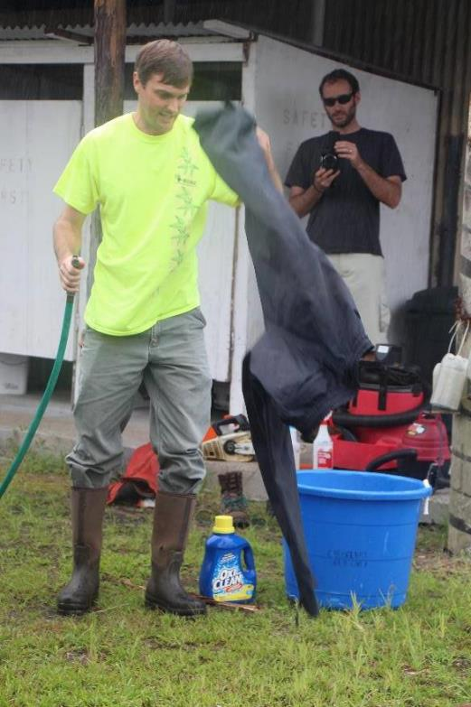
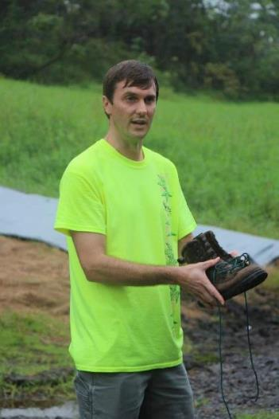

Clean Shoes & Gear
Clean mud off gear/boots
Wash using a detergent
Notes:
As discussed before, soil in infected stands can be contaminated with sawdust that contains Ceratocystis spores. It is important to clean any soil off of any gear that was used in infected forests. This includes outerwear, backpacks, as well as shoes and clothes.

Slide 12
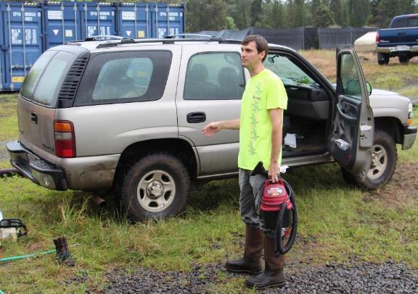
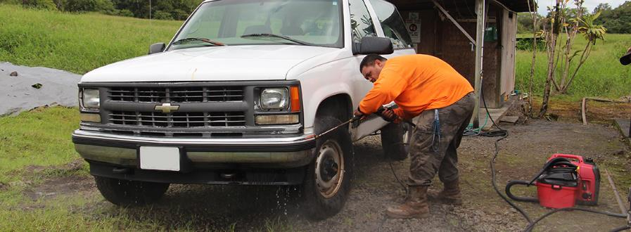
Wash Vehicles
Tires, wheel wells, undercarriage
Remove all soil and mud
Notes:
Vehicles also need to be cleaned with soap and water to remove any contaminated soil. It is important to clean mud out of wheel wells.

Slide 13
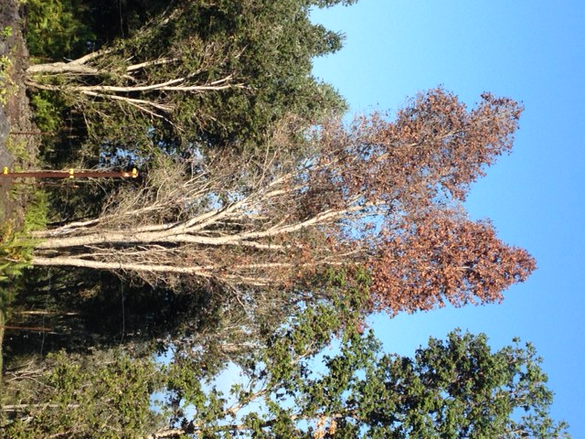
If you see a suspect ROD tree
In North Hilo, Hāmākua, or Kohala
Let BIISC or DOFAW know
Contact landowner
Avoid disturbing the tree or area until diagnosed
Notes:
If you detect a tree that shows ROD-like symptoms on an island other than Hawaii, notify the ISC or Division of Forestry and Wildlife (DOFAW) office for that island or district. They will arrange to take samples and have samples shipped to Lisa Keith’s lab in Hilo via HDOA. Samples should not be sent inter-island; they should be given to the local HDOA Plant Quarantine Office and they will ship them. (Moloka’i and Maui do need to ship as there is no HDOA office there but still contact Maui HDOA PQ).
Don’t worry about organizing a response right now. If there is a positive sample on another island there will be statewide efforts to determine the best response.
If you are on Hawaii Island, there’s only need to send samples to the lab if they are in a relatively new area such as Hamakua or Kohala. We know the fungus is all over Puna, Ka’u, and Kona.

Slide 14
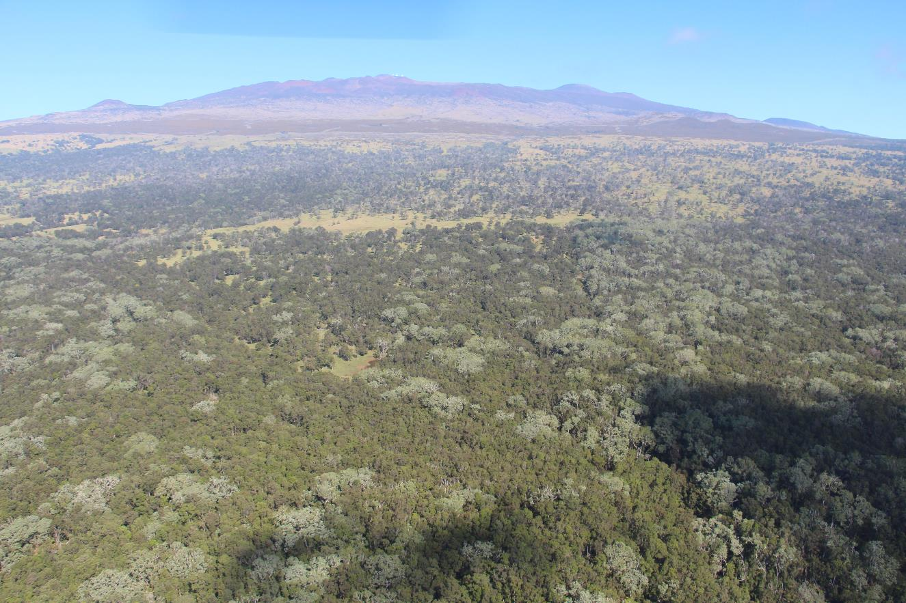
Most ‘ōhi‘a forests are still healthy
Notes:
Most ohia forests on Hawaii Island are still healthy. While there are about 135,000 acres affected with ROD, many of these areas only have about 5% of the trees infected. The majority of Hawaii Island ohia forests are still healthy.

Slide 15

Hilo: Palace Theater, August 4th
Waimea: Kahilu Theater, August 17th
Kona: Aloha Theater, August 31st
Showtimes 6:30 – 8:30 pm

Slide 16


Slide 17








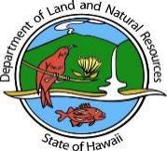

Funding
University of Hawai‘i Foundation
Hau‘oli Mau Loa Foundation
Gordon and Betty Moore Foundation
Dorrance Family Foundation
Koaniani Fund
Marisla Foundation
Hawai‘i Community Foundation
Hawai‘i Tourism Authority
Ka‘ulunani Urban Forestry Program
Hawai‘i State Legislature
Hawai‘i Invasive Species Council
Hawai‘i Department of Agriculture
Hawai‘i Department of Land and Natural Resources
University of Hawai‘i
U. S. Department of Agriculture
U. S. Department of the Interior
U. S. Geological Survey Service First
Notes:
Some of the agencies and foundations that are funding ROD work

Slide 18



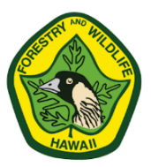
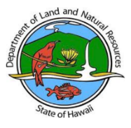






The ROD Working Group
USDA Forest Service
USDA Agricultural Research Service
UH Mānoa College of Tropical Agriculture and Human Resources
Hawai‘i Department of Agriculture
Department of Land and Natural Resources – Division of Forestry & Wildlife
US Geological Survey
Hawai‘i Invasive Species Council
Invasive Species Committees
Coordinating Group on Alien Pest Species
Carnegie Airborne Observatory
The Nature Conservancy
Iowa State University
And many others…
Notes:
The ROD group has many agencies participating. Here are most of the most important ones. Feel free to add local ones.

Slide 19
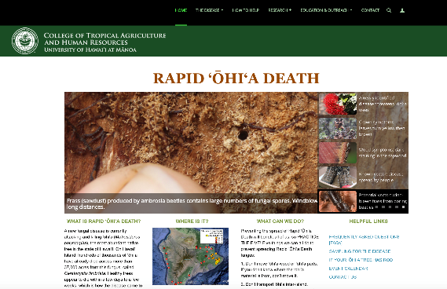
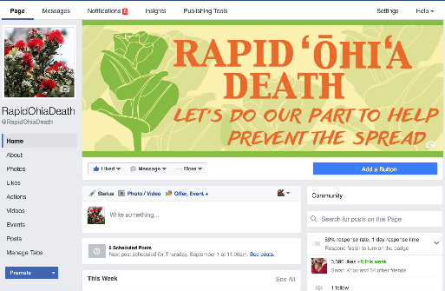
Mahalo!
RapidOhiaDeath.org
J. B. Friday
Extension Forester
University of Hawai‘i
Cooperative Extension Service
EMAIL: jbfriday@hawaii.edu
PHONE: 808-969-8254
Corie Yanger
Rapid Ohia Death Ed. Specialist
University of Hawai‘i
Cooperative Extension Service
EMAIL: ohialove@hawaii.edu
PHONE: 808-969-8268
facebook.com/rapidohiadeath
4,000 “likes”
Notes:
Our contact info. Add yours!
Feel free to contact us for information on ROD. Please do not send us homeowners with questions about landscape trees. Thanks.

