Slide 1
Hawaii National Park transitions to
Hawai‘i Volcanoes National Park
1916 – 2018 but first…. Public interest is necessary

Slide 2
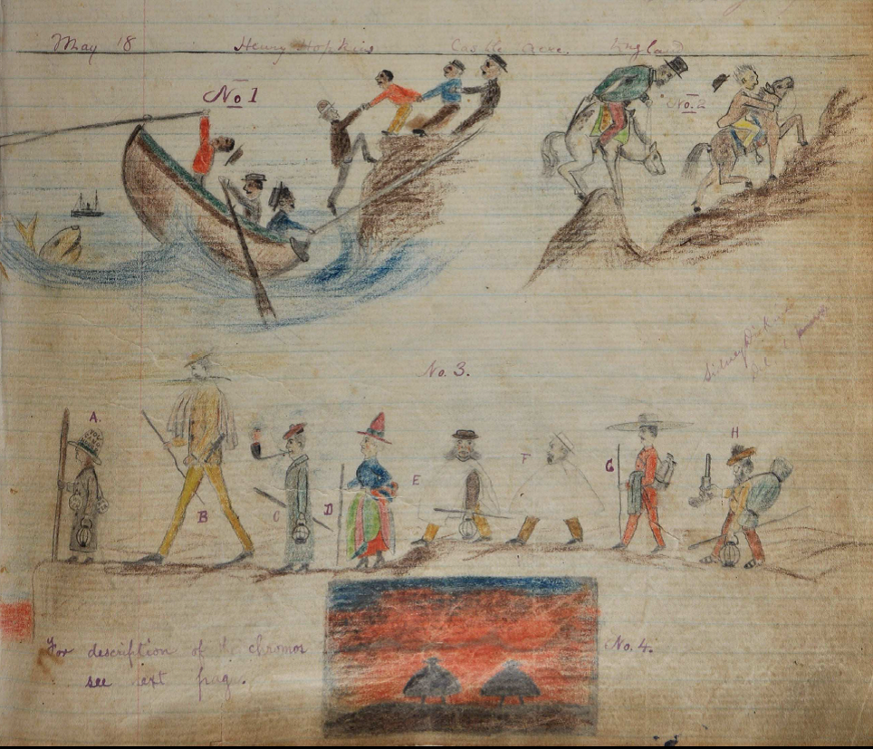
“Excursion from Honolulu to Kilauea, May 16th to 21st, 1887”
“Design No. 3 hands down to an admiring posterity the individuals of the party who made the above memorable excursion at the above dates, as they appeared on their march to the crater on Wednesday afternoon, May 18th, and at the moment when they came upon the stupendous sight of the volcanic fires.”
HAVO 395. Volcano House guest register, 1885 to 1891.

Slide 4
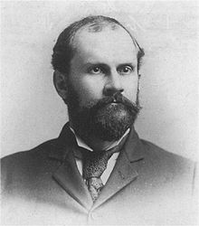
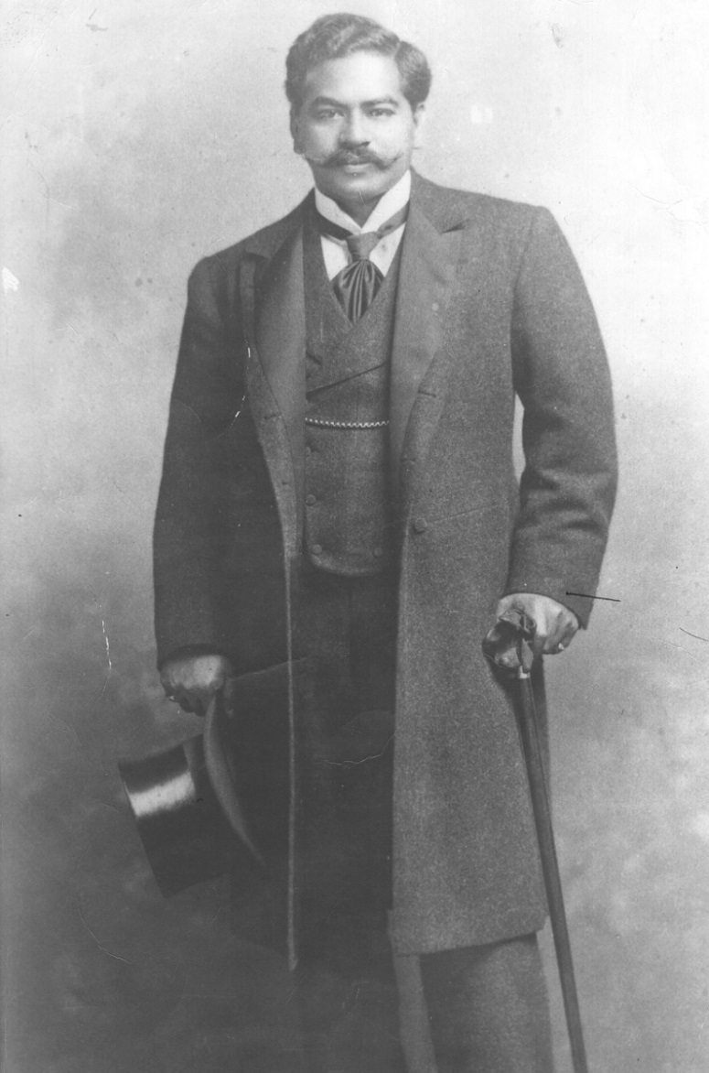
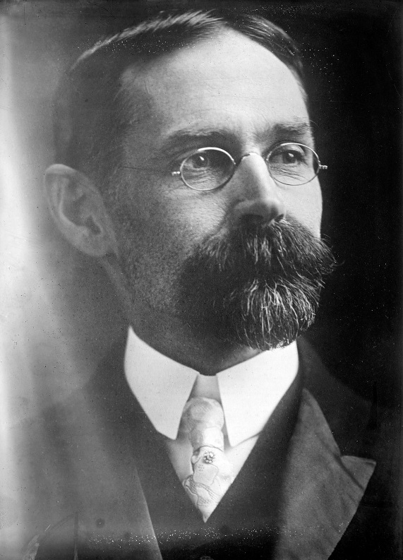
Lorrin Thurston Thomas Jaggar, Walter Frear, and Jonah Kuhio Kalanianaole

Slide 5
HAWAI‘I VOLCANOES NATIONAL PARK ENABLING LEGISLATION
Congress established Hawaii National Park (later to become Hawai‘i Volcanoes National Park) on August 1, 1916, declaring:
  The tracts of land on the Island of Hawai‘i and the Island of Maui, in the Territory of Hawai‘i … shall be perpetually dedicated and set apart as a public park or pleasuring ground for the benefit and enjoyment of the people of the United States … [and provide for] … the preservation from injury of all timber, birds, mineral deposits, and natural curiosities or wonders within said park, and their retention in their natural condition as nearly as possible.

Slide 6
The first land to become part of the park.

Slide 7
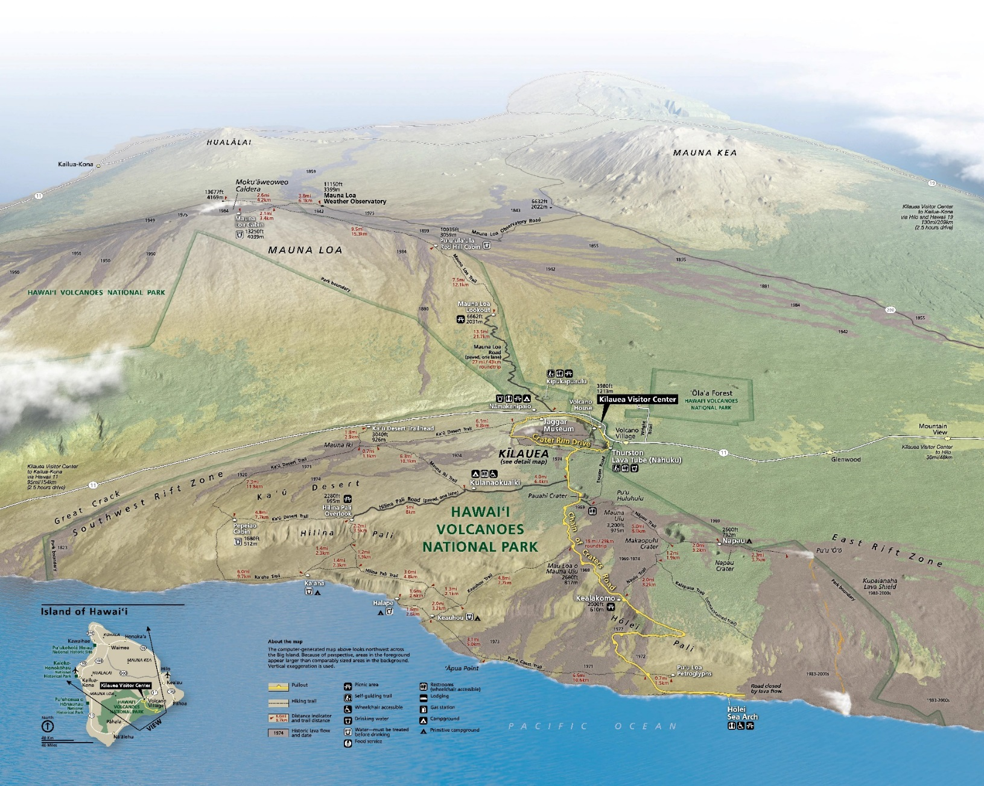
The expansion of National Parks:

Slide 8
NPS and the acquisition of land muse meet three rules:
The National Parks must be maintained unimpaired for the use of future generations;
That the Parks are set apart for conservation, health, and pleasure of the people;
That the national interest must dictate all decisions affecting public or private enterprise in the Parks.

Slide 9
The Park Service, which employs Park Rangers, is interested in the preservation of land in its natural state, while the Forest Service, which employs Forest Rangers, is interested in the conservation of land, and permits activities on some of the land which it administers, such as logging, hunting, and the erection of summer homes, which are not permitted in National Parks.

Slide 10
NPS Organic Act – August 25, 1916
"....to conserve the scenery and the natural and historic objects and the wild life therein and to provide for the enjoyment of the same in such manner and by such means as will leave them unimpaired for the enjoyment of future generations."

Slide 11
Acquisition of Land at Hawai‘i Volcanoes National Park Requires:
An Act of Congress
Act of 1920: Authorized the governor of the Territory of Hawai‘i to acquire privately owned lands and rights-of-way within the boundaries of Hawaii National Park.
Act of 1922: Added additional lands to the park, specifically those lands of the Ka‘ū Desert and Kapāpala.
Act of 1928: Modified the park boundary on the Island of Hawai‘i.

Slide 12
Hawai‘i Volcanoes National Park Expands:
Act of 1930: Stated that the United States had sole and exclusive jurisdiction over Hawai‘i National Park and further defined the purpose of the park and the activities.
Act of 1959: Formed part of the legislation for the admission of Hawai‘i to the Union, approved March 18, 1959.
Act of 1961: Separated the parks on Maui and Hawai‘i, officially establishing the park on the Island of Hawai‘i as “Hawai‘i Volcanoes National Park.”

Slide 13
Expansion of Hawai‘i Volcanoes National Park continues:
Act of 1978: Added 269 acres to Hawai‘i Volcanoes National Park. (Ola‘a Tract as Wilderness)
Act of 2000: Eliminated restrictions on the acquisition of certain lands contiguous to Hawai‘i Volcanoes National Park.

Slide 14
With the land comes responsibility:
"....to conserve the scenery and the natural and historic objects and the wild life therein and to provide for the enjoyment of the same in such manner and by such means as will leave them unimpaired for the enjoyment of future generations."

Slide 15
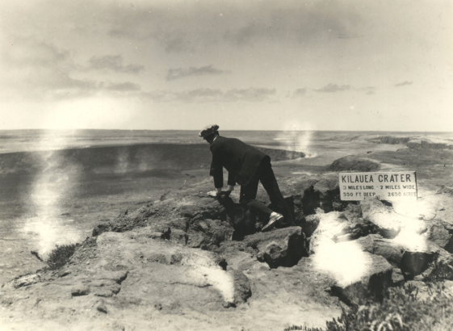
Thank you

