Slide 2
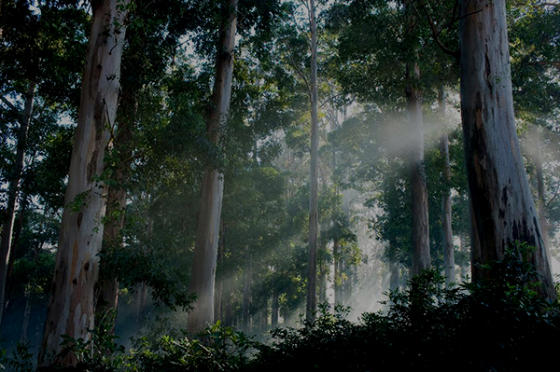

Honua Ola is a state-of-the-art revitalization of an existing facility, replacing imported fossil fuel with local, renewable resources to produce energy.

Slide 3
What is Honua Ola?
Honua Ola is replacing imported fossil fuel with local, renewable resources to produce energy.
Once operational, Honua Ola’s plant in Pepeʻekeo will use state-of-the-art technology to produce up to 21.5 megawatts of firm, renewable power fueled by organic material grown on-island.
Responsibly managed forests, including the replanting of trees, will offset the carbon emissions of the power production process.

Slide 4
What’s In A Name?
“Honua Ola” in Hawaiian means “living earth.”
Our name represents our commitment to creating sustainable green energy, supporting local agriculture, working to reduce our dependence on fossil fuels, and stimulating our local economy.
As we continue to transition from the Hū Honua name with which we started the project, we recently launched our brand new website at honuaolabioenergy.com

Slide 5
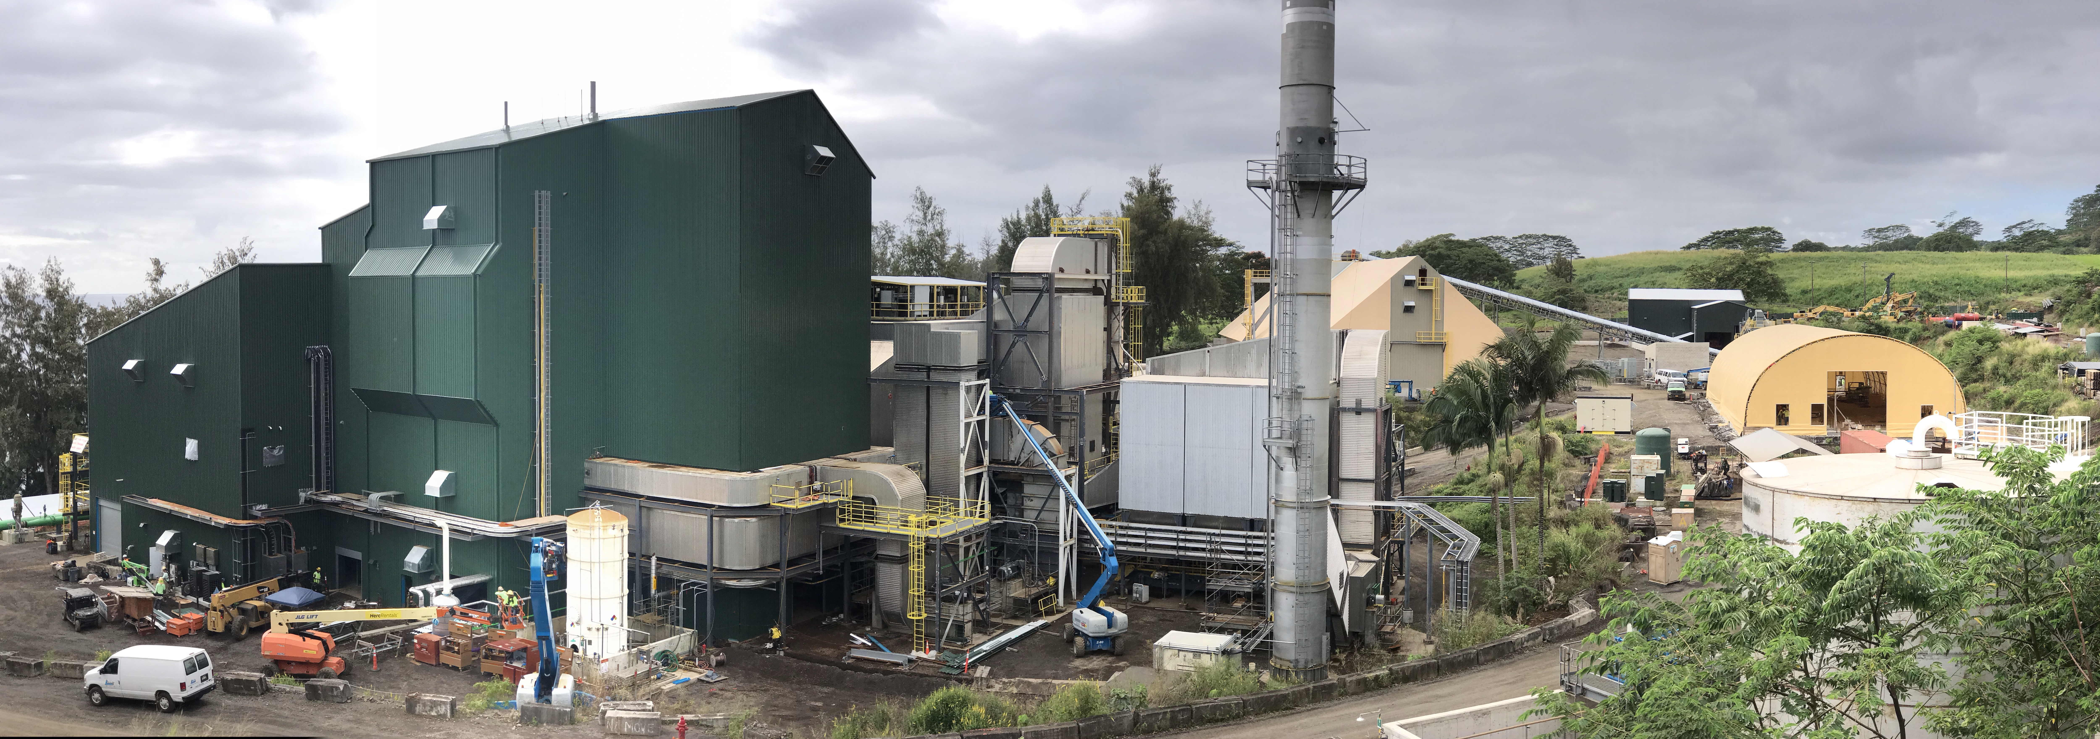

Slide 6
What is Honua Ola?
The site on which Honua Ola sits has been industrial for over a century, and in power production for nearly a quarter century.
1857: Kaupakuea Sugar Plantation established
1874: Plantation sold, name changes to Pepeʻekeo Sugar Company
1971: Pepeʻekeo Sugar merges with Mauna Kea Sugar, name changes to Hilo Coast Processing Company

Slide 7
What is Honua Ola?
The site on which Honua Ola sits has been industrial for over a century, and in power production for over a quarter century.
1974: A new mill is built, the building being modernized into Honua Ola today
1985: Hilo Coast Processing begins burning coal for power in addition to bagasse
1994: Sugar processing ends, plant burns coal as Hilo Coast Power Company until 2004

Slide 8
Honua Ola is a state-of-the-art revitalization of an existing facility, replacing imported fossil fuel with local, renewable resources to produce energy.

Slide 9
Minimizing Environmental Impacts
Honua Ola’s output (up to 21.5 MW) will prevent the need to import up to 250,000 barrels of oil every year.
Bioenergy provides predictability and firm stability that enables more renewables, like solar and wind.
The carbon dioxide released by the plant will be offset by the growth of forest, which will capture an equivalent amount of carbon dioxide. With the displacement of existing fossil fuel plant generation, a significant reduction in carbon is expected.

Slide 10
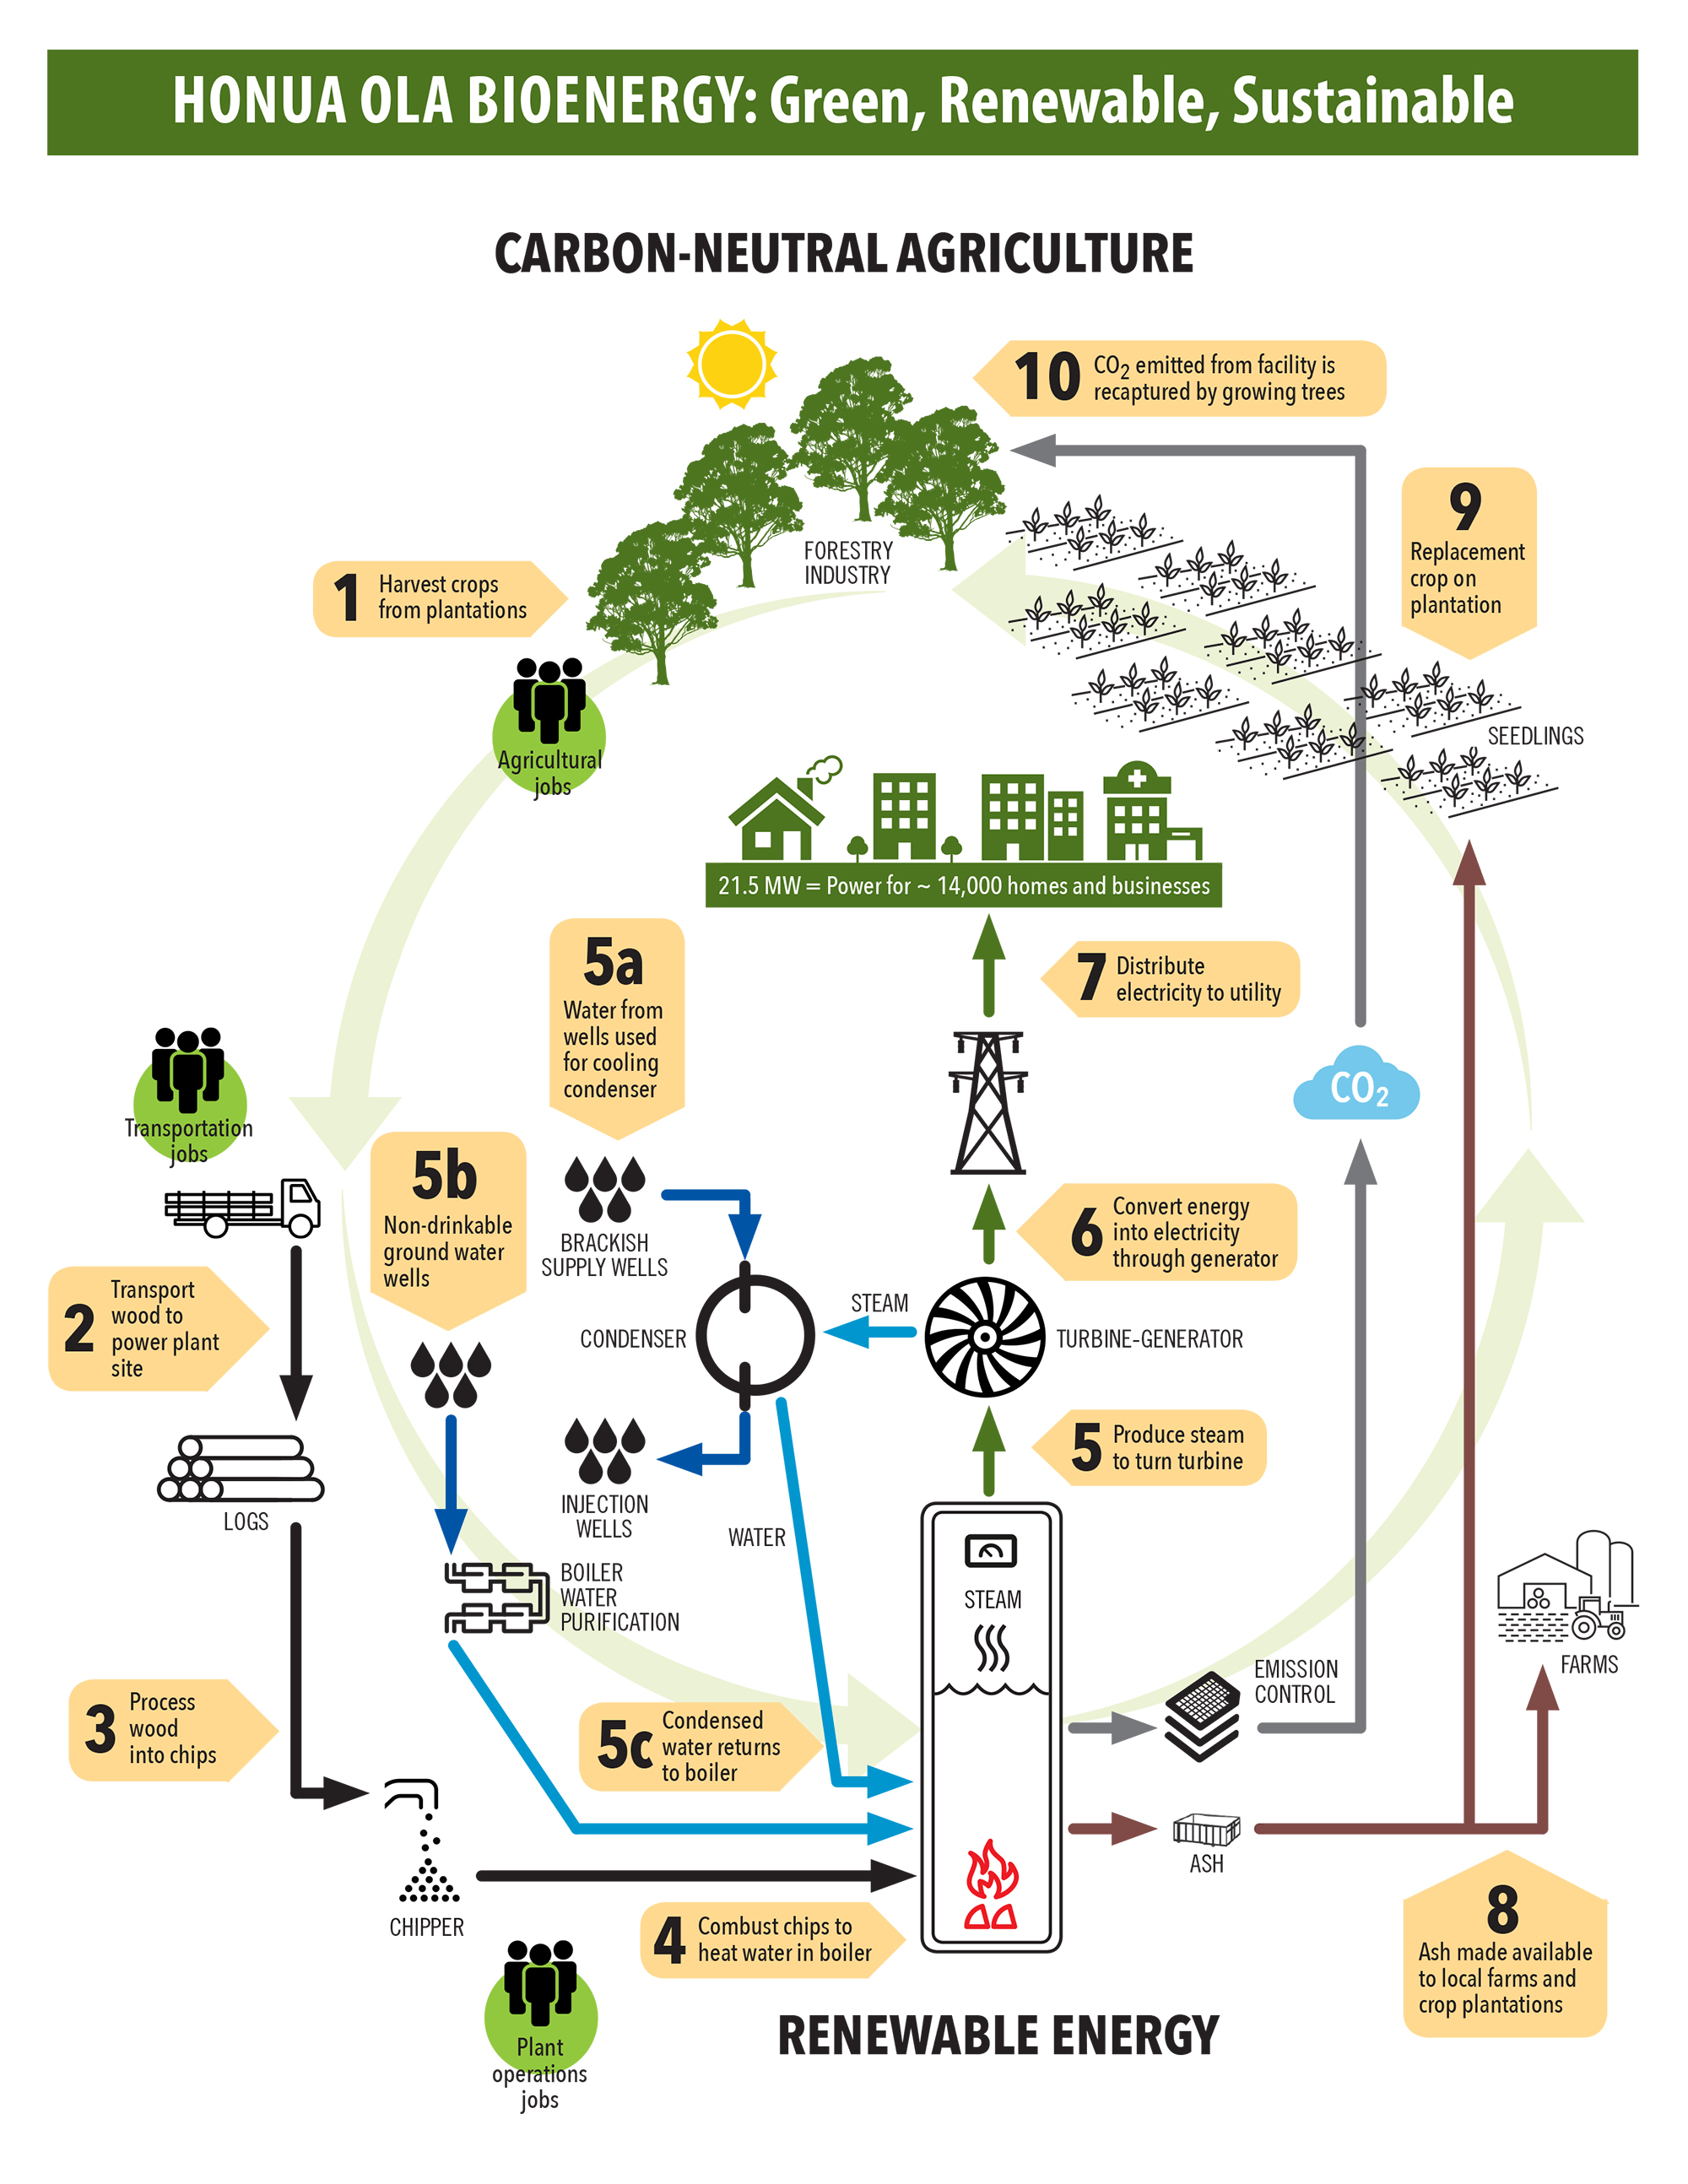

Slide 11
Minimizing Environmental Impacts
Honua Ola’s modern emissions controls meet or exceed current air emissions standards and comply with applicable state and federal requirements.
Water used in the cooling process will be pumped from and returned to the aquifer below the plant. Essentially the same volume and nature of water will be reinjected.
Four water treatment products will be used to prevent scale and corrosion, one to help control buildup of manganese, and one to prevent calcium carbonate buildup. None of these products contain Clean Water Act-listed chemicals above minimal levels (<1%).

Slide 12
Minimizing Environmental Impacts
Water being returned to the aquifer will be warmer than the water pumped out, but modeling of the heaviest-use scenario shows the ocean water temperature nearby will not increase by more than 1.0°C (1.8°F), which is within state and federal standards.
Water will be returned to the aquifer below sea level, and the first 120 feet of the wells will be lined to prevent erosion of the cliff face.

Slide 13
Regulatory Update
Honua Ola is committed to completing the regulatory process that governs its construction and operation, which includes public input.
Granted: Air Permit (State), Amendment to Special Management Area Permit (County).
In Process: Underground Injection Control Permit (State), Storm Water Permit (State), Solid Waste Permit for beneficial use of wood ash (State)
Pending: A challenge to Honua Ola’s Power Purchase Agreement (PPA) with the local utility remains at the Hawaiʻi Supreme Court, with no timetable for an expected ruling.

