Slide 1
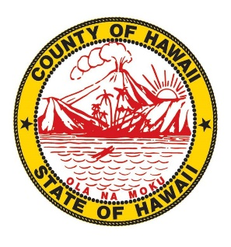
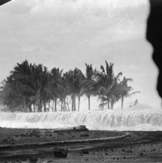
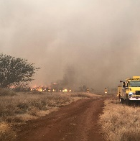
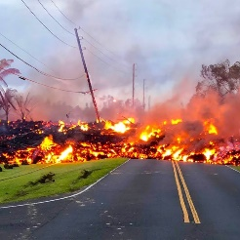
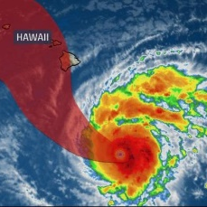
Hawaii County Hazard Mitigation Plan-Update
Phase 1 Public Meetings
Rob Flaner, CFM
Cindy Rolli, CFM

Slide 2
Tonight’s Speakers
Talmadge Magno – Civil Defense Administrator
  30 years with National Park Service providing; emergency management and law enforcement throughout western US and Hawai‘i.
  Last 8 years of career served as Chief Ranger of Hawai‘i Volcanoes National Park
Rob Flaner – Hazard Mitigation Program Manager, Tetra Tech, Inc.
  Technical consultant to Hawaii County
  Former Federal Emergency Management Agency (FEMA) contractor
  Facilitated over 75 successful mitigation planning efforts since 2003
Cindi Rolli – Lead Project Planner, Tetra Tech, Inc
  Leading the planning process for this update
  Also supporting the County’s Recovery efforts

Slide 3
What are we going to talk about?
Provide a brief overview of the drivers for planning
Describe the Hawaii County planning process
The Hazard Mitigation Working Group
Vision and Goals for the plan
The Risk Assessment
Alternatives Analysis
Next Steps
Questions

Slide 4
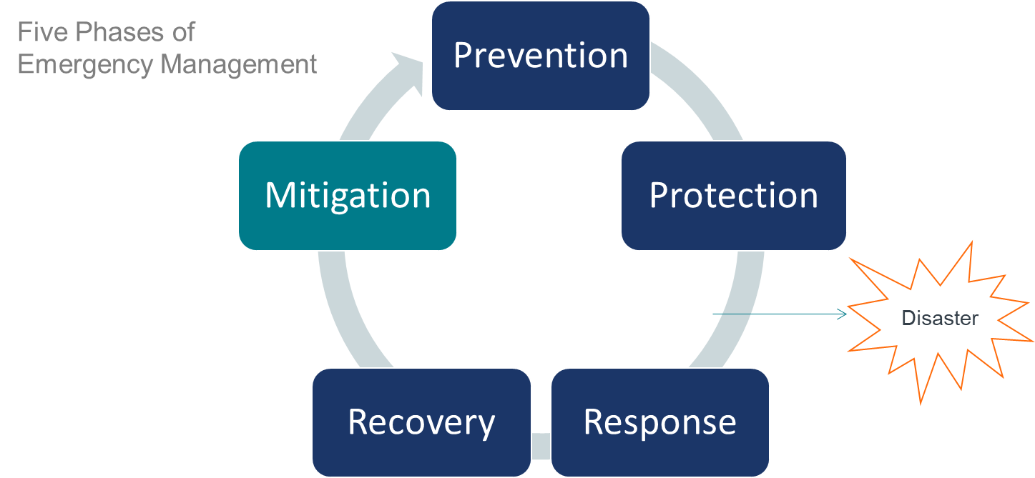
What is Mitigation?
“Sustained action taken to reduce or eliminate long-term risk to life and property”

Slide 5
What is the Disaster Mitigation Act (DMA)?
Federal legislation that establishes a pre-disaster hazard mitigation program and new requirements for the national post-disaster Hazard Mitigation Grant Program (HMGP)
“No Plan, no money!”

Slide 6
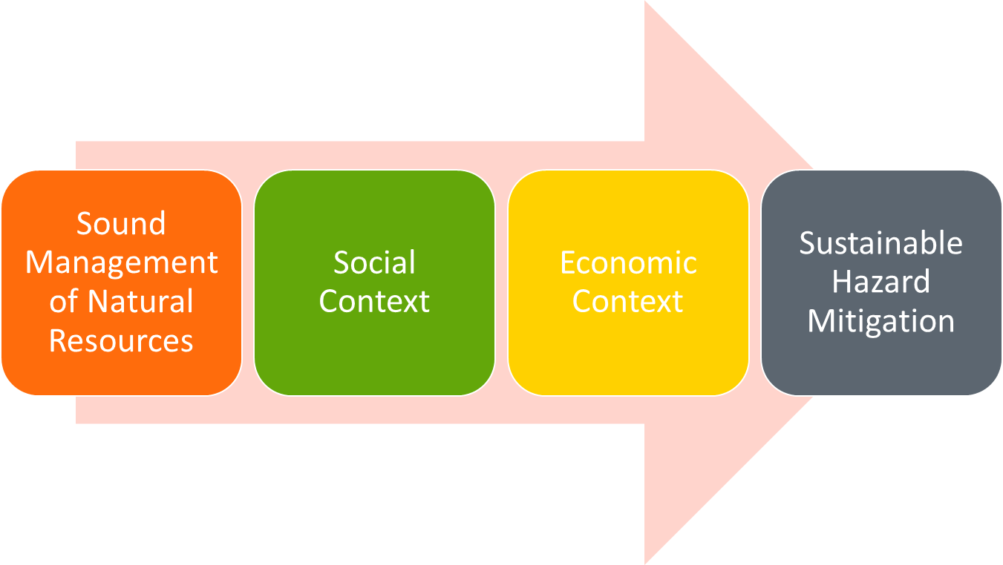
Disaster Mitigation Act of 2000

Slide 7

Why Plan?
  Establish/maintain eligibility for grant funds
  Preparedness: pro-active vs. reactive
  Sustainability
  Key element in emergency management
  Can set the course for response and recovery to impacts from natural disasters
  Requires commitment and support from both elected officials and their constituents
This Photo by Unknown Author is licensed under CC BY-SA-NC

Slide 8
What is required in a DMA plan?
According to Section 201.6, 44CFR, an approved plan must:
Engage the public through all phases of the plan’s development
Review and incorporate plans and programs that can support/enhance hazard mitigation
Assess risk to natural hazards that impact a planning area
Identify a plan maintenance strategy
Identify and prioritize actions

Slide 9
This is a Plan Update
FEMA Requires Local Hazard Mitigation Plans to be updated every 5-years.
The last Plan for Hawaii County was approved in 2015
  Addressed 13 hazards of concern
  Identifies 8 goals and 20 objectives
  Identified and prioritized over 30 actions to address those hazards with the greatest impact
This plan update will:
  Revisit the risk assessment
  Reengage the public
  Confirm vision, goals and objectives
  Review core capabilities
  Reconcile past actions
  Identify and prioritize new actions

Slide 10
The County’s Objectives for this Plan Update Process
Promote the wise use of resources and increase coordination among Hawaii County programs and stakeholders
Leverage the County’s on-going recovery efforts from the Kilauea volcano eruption
Identify natural hazard risks and vulnerabilities for the people, property and economy of Hawaii County
Develop specific strategies to reduce disaster risk and improve resilience

Slide 11
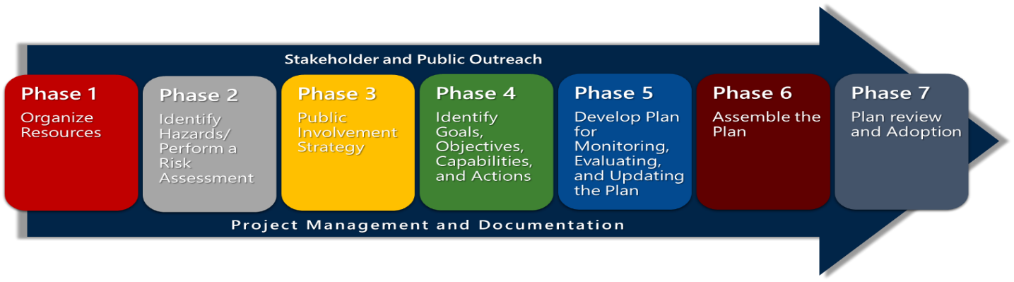
The Plan Update Work Plan
7 phase scope of work
Follow the 10-Step Planning script from FEMA’s Community Rating System (CRS Program).
Centers on a comprehensive risk assessment and active public engagement strategy

Slide 12
The HMP Working Group
A 24 member Working Group is overseeing the plan update
Multi-disciplined representation
Stakeholders (business, academia, government)
Emergency Management
Has met 2 times since October 2019
Meets 3rd Tuesday of every month from 2-4pm at the Aupuni Center Conference Room
All meetings are open to the public

Slide 13

The Plan’s Mission Statement
Identify risks to life and property resulting from hazards events to determine viable actions that will reduce the risk and enable resilient communities.
This Photo by Unknown Author is licensed under CC BY-NC-ND

Slide 14

Utilize state-of-the-art methods and technologies as well as local knowledge to identify hazards, risks, and capabilities.
Ensure that all critical facilities and infrastructure withstand hazard incidents and have contingency plans to restore services quickly.
Protect natural and cultural resources to the extent practicable that mitigate hazards.
Promote actions that support land use planning and regulations designed to ensure long-term resiliency.
Promote community risk reduction and preparedness through public education, training, and awareness.
Improve capabilities to implement response protocols and continuity of operations and services.
Strengthen partnerships and leverage existing resources and capabilities to identify, assess, and reduce the impact of hazards.

Slide 15
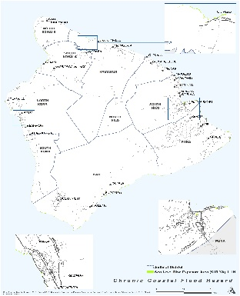
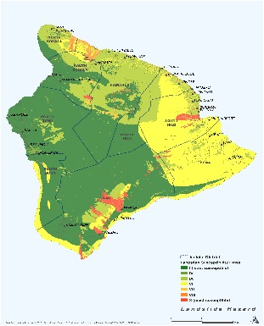
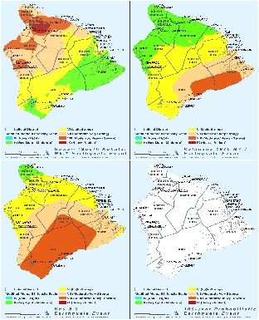
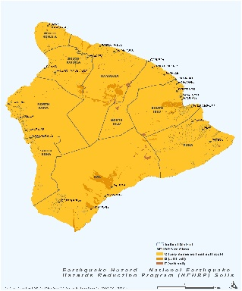
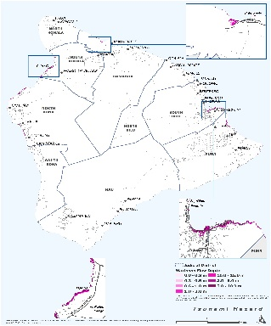
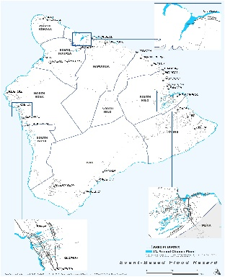
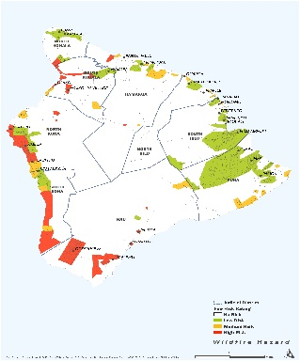
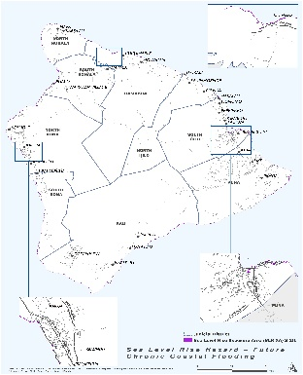
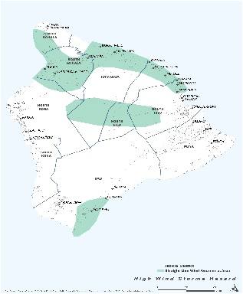
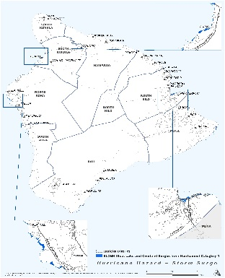
The Risk Assessment

Slide 16

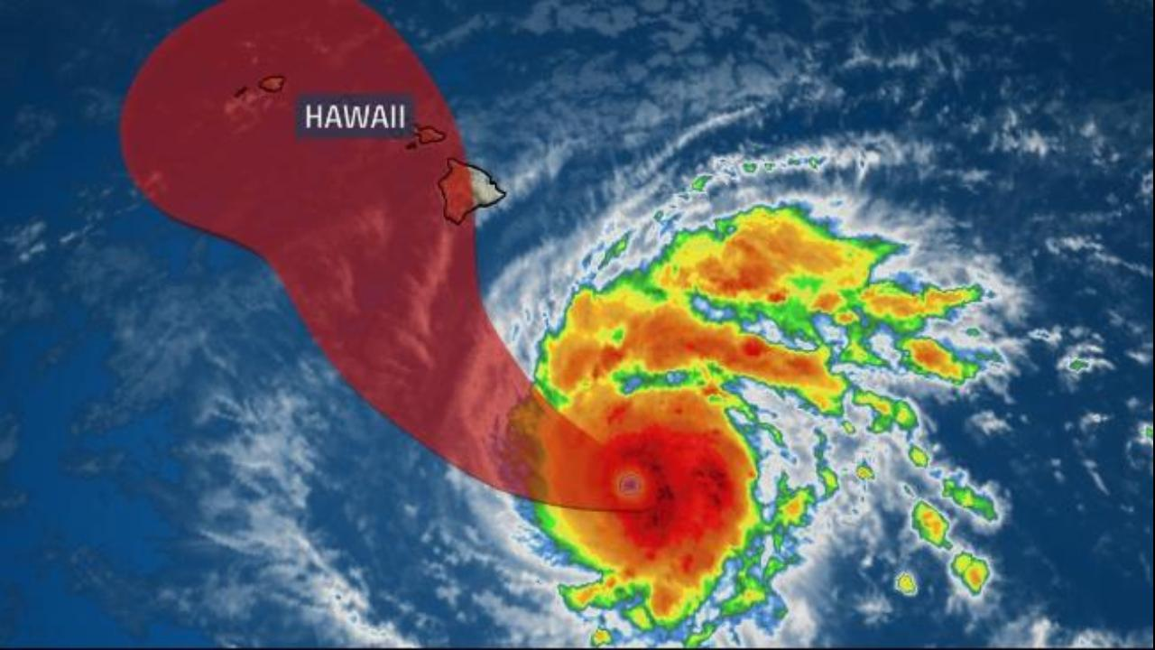
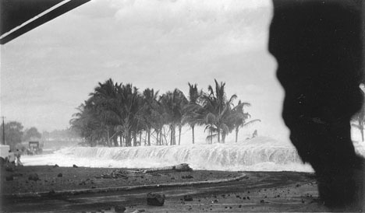
What is Risk?
Risk is defined as a function of :
  Hazard
    Source of potential danger or adverse condition
  Exposure
    Manmade or natural features that are exposed to the hazard
  Vulnerability
    Damage susceptibility of the exposed features
  Capability
    Regulatory Capability
    Technical Capability
    Financial Capability

Slide 17
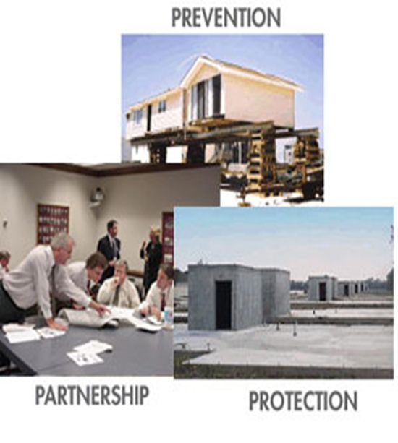
Risk Reduction
To Reduce Risk:
  Manipulate the Hazard:
    structural flood control
  Reduce Exposure:
    property acquisition
  Reduce Vulnerability:
    retrofitting
  Increase capability:
    $, preparation, technical assistance, planning

Slide 18
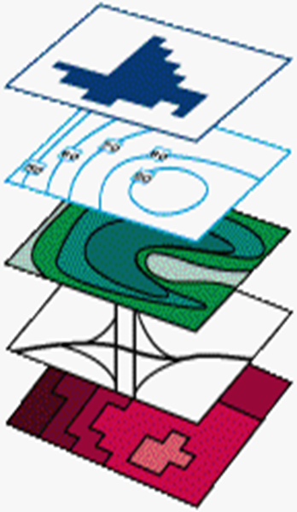
Development of the Hawaii County Risk Assessment
5
Hazard Locators (Soils, floodplains, landslides)
Inventories (Buildings, roads, critical areas)
Exposure (Direct and Indirect)
Disaster Scenario (Vulnerability Assessments)
Suggest Risk Reduction Measures
1

Slide 19
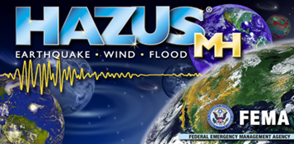
What is Hazus?
HAZUS-MH is a powerful risk assessment methodology for analyzing potential losses from floods, hurricane winds and earthquakes.
HAZUS outputs include:
  Number, location, types, and occupancy of vulnerable buildings
  Actual or assessed values of the vulnerable buildings
  Critical facilities
  An estimate of losses per hazard
  Debris accumulation

Slide 20
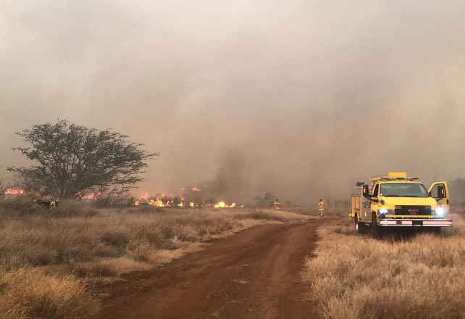
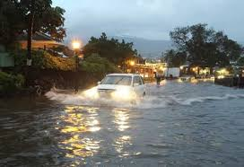
The Hawaii County Risk Assessment
The foundation of the plan is a comprehensive risk assessment of 10 natural hazards of concern
  Assess hazard
    Past events
    Areas most affected
    Frequency
    Severity
    Warning time for response
  Determine Exposure
  Assess Vulnerability
    Loss Estimation

Slide 21
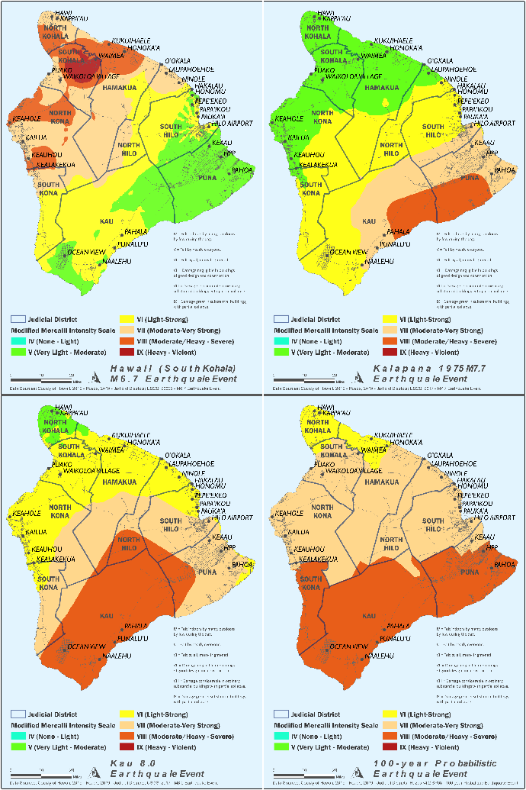
The Hazards of Concern
Natural Hazards
  Volcanic Hazards
  Dam Failure
  Drought
  Earthquake
  Flood
  Landslide
  High Wind Storms
  Hurricane
  Storm surge/High Surf/Chronic Coastal Flood
  Climate Change/Sea Level Rise
  Tsunami
  Wildfire
  Invasive Species
Non-Natural Hazards
  Supply Chain
  Mass Gathering Events
  Cyber

Slide 22
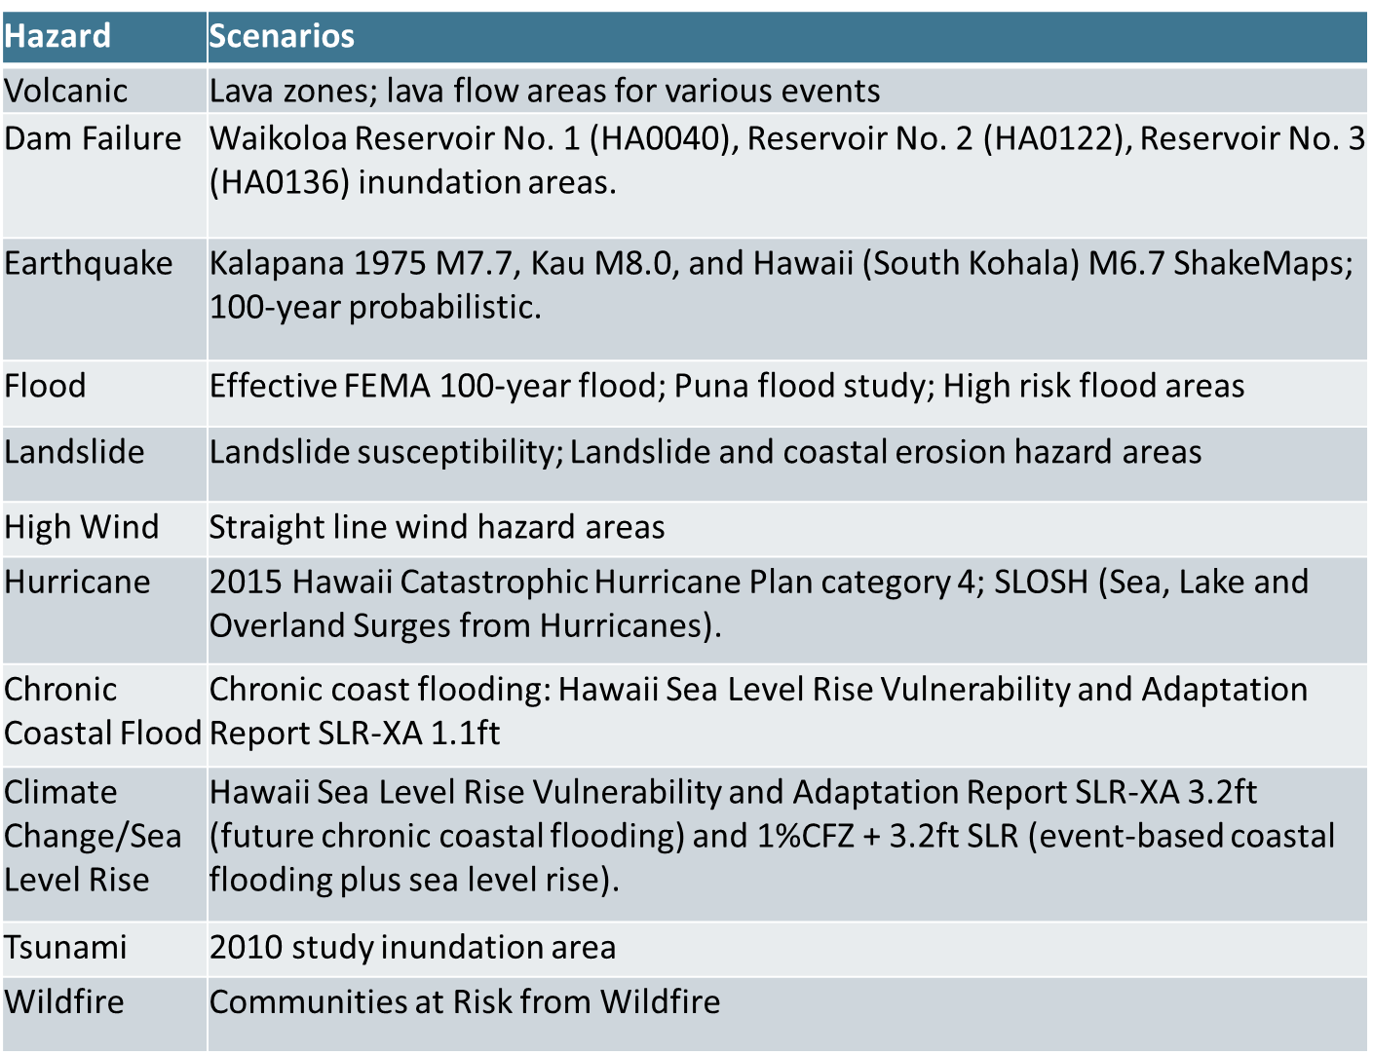
Hazard Scenarios

Slide 23
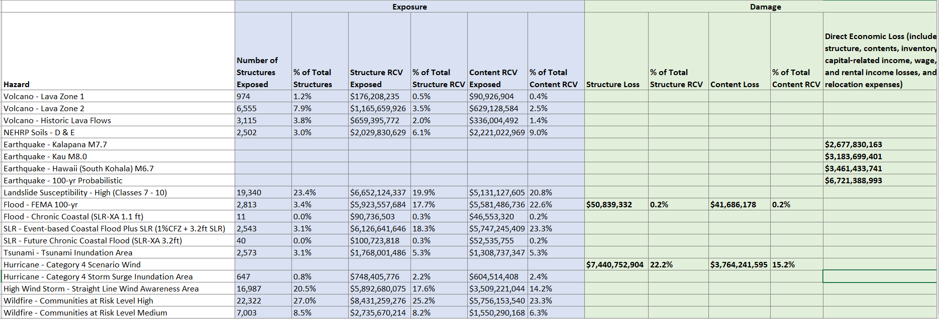
Preliminary Results

Slide 24
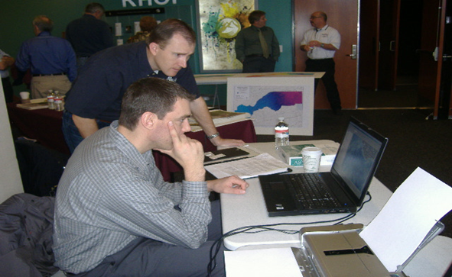
Citizens Role in this Open House
Educate yourself on risk!
Provide feedback to the planning team on your perception of the risk. Does it appear accurate? Does it support what you may have experienced?
Complete a Survey
Visit a Risk workstation

Slide 25
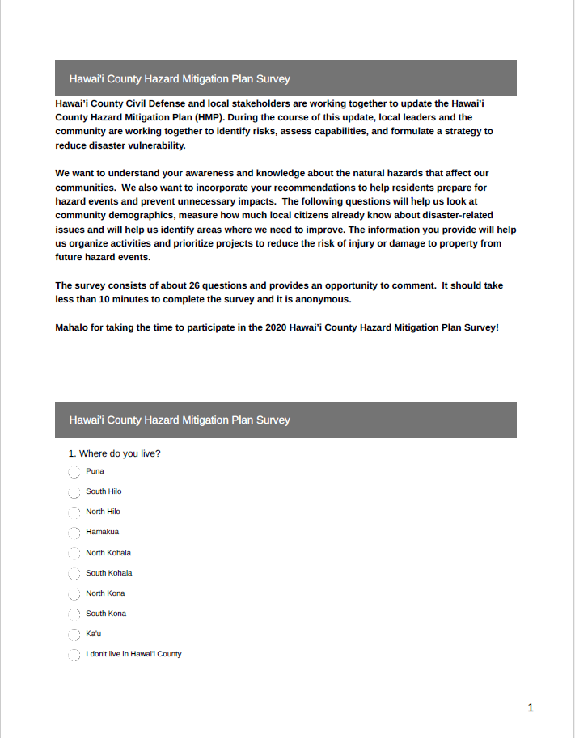
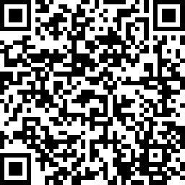
Hazard Mitigation Plan Public Survey
Please complete the Public Survey:
https://www.surveymonkey.com/r/HawaiiCountyHMP

Slide 26
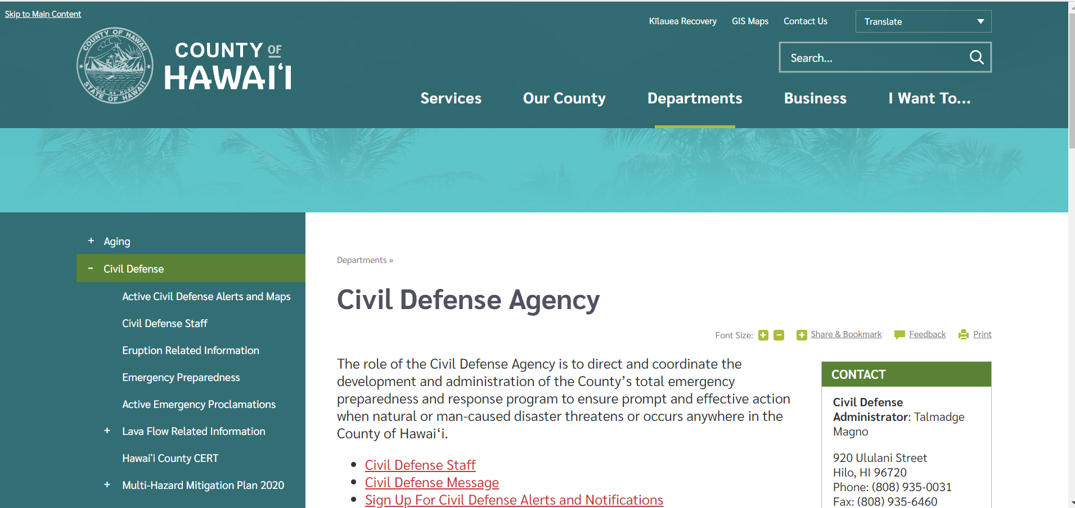
For More Information
Please visit the County website at:
https://www.hawaiicounty.gov/departments/civil-defense
This site includes:
FAQs
Working Group
  meeting Agendas/minutes
The draft Plan
Prior Plan

Slide 27
Next Steps
Confirm Objectives
Review Core Capabilities
Identify alternatives
Identify/Prioritize Actions
Assemble the Plan
Phase 2 public outreach
Submit the Plan
Adopt the Plan

Slide 28

Questions?

